Slide 3
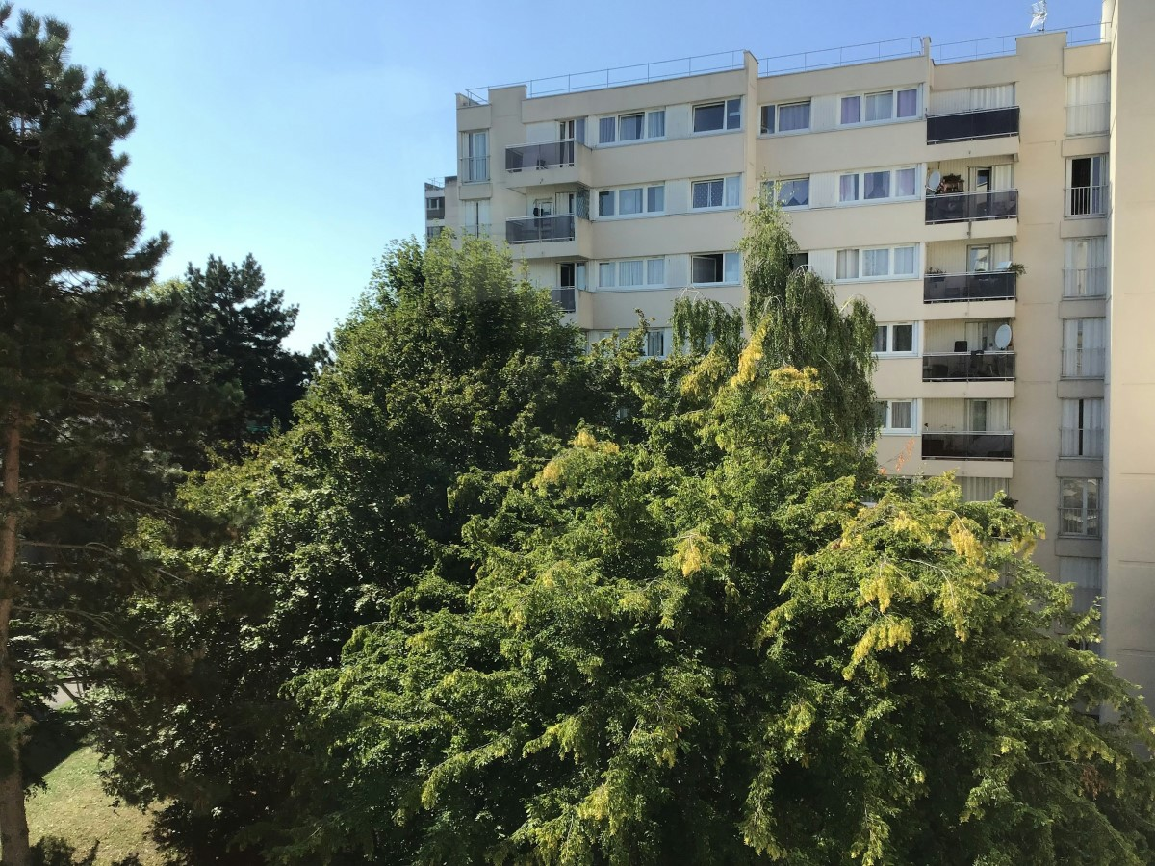
Today’s VoteTopic:
Would you like to see more wildlife brought into your built-up area?
UNCRC Article 24:
Health, water, food, environment
UN SDG 15:
Life on
land
VfS Key Theme 3:
Environment & climate change
Notes:
Images
Unsplash

Slide 4
1
Close to home
Pair discussion (2-3 mins)
Where is the best area of nature near to you? What lives in this area?
Notes:
Images
Microsoft Office 365

Slide 5
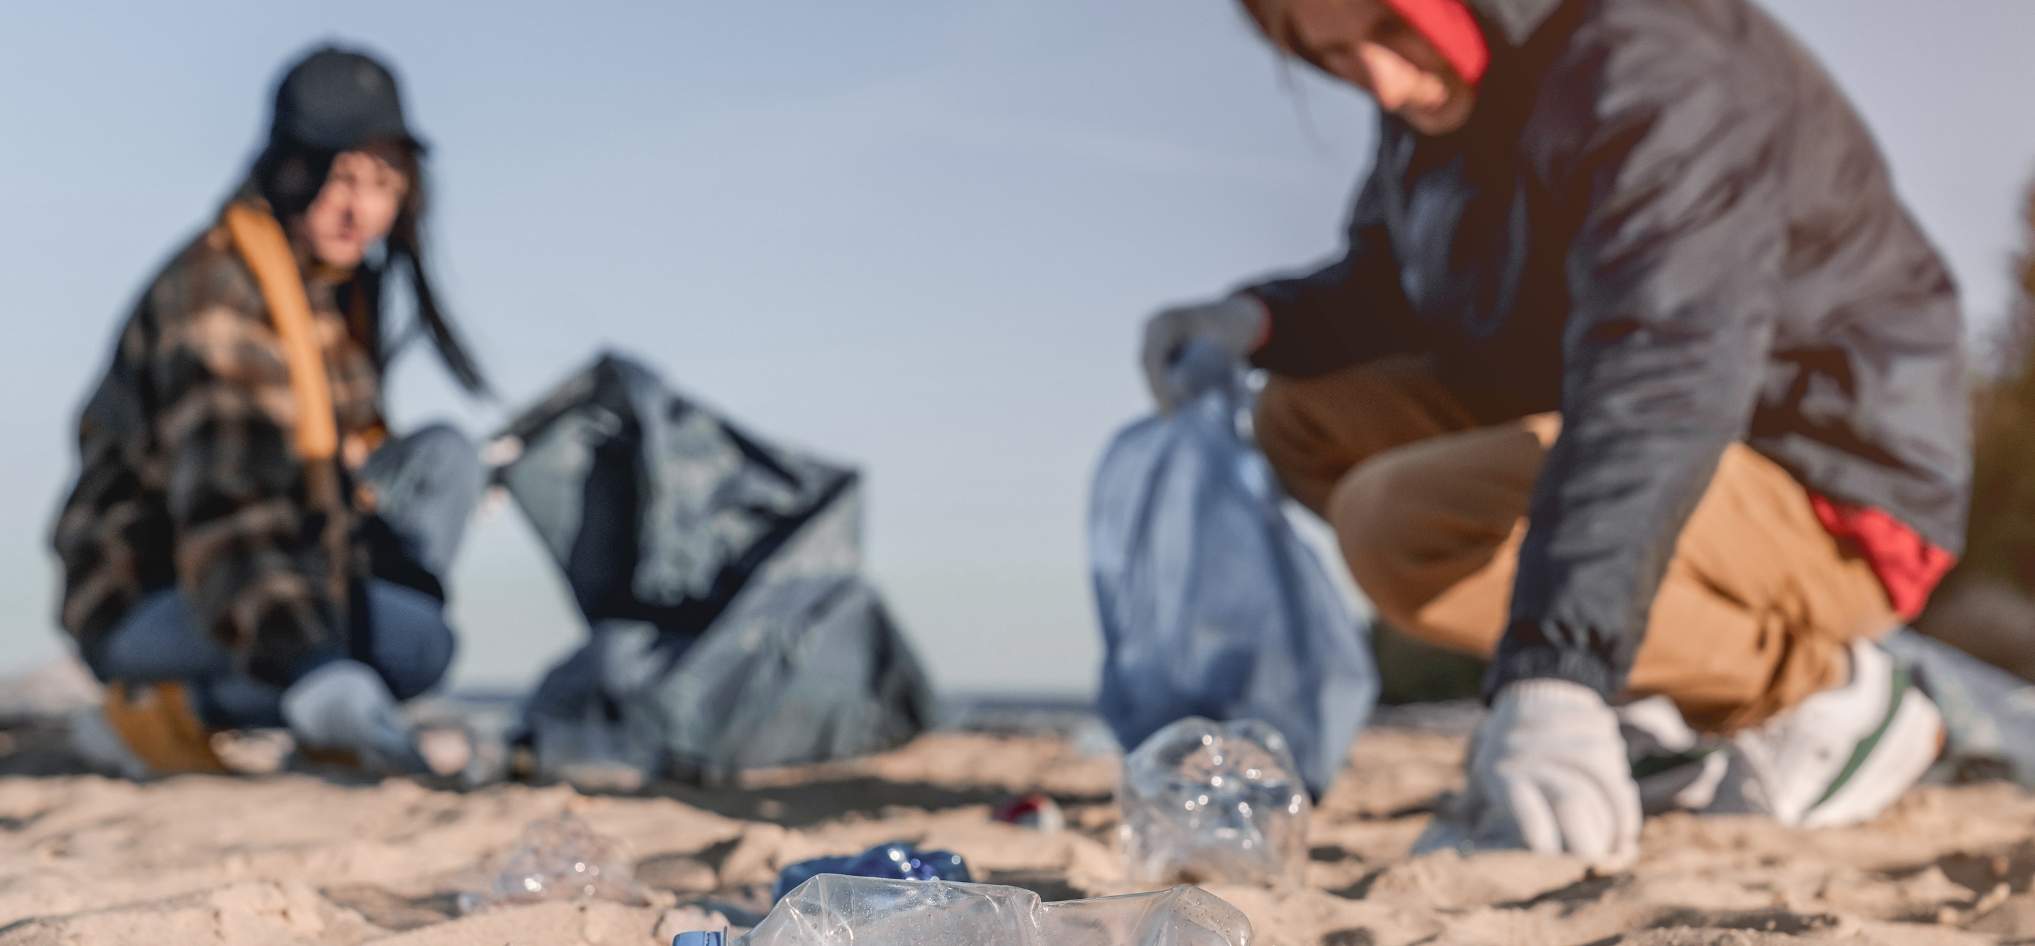
2
Why are we talking about this?
VotesforSchools has joined forces with Eco-Schools to support their Healthy Summer Toolkit.
This lesson gives you the chance to be heard by decision-makers from across the country! Let’s find out more about what you will be discussing today…
Notes:
Images
Microsoft Office 365
Courtesy of Eco-Schools
References
https://www.eco-schools.org.uk/healthy-summer-toolkit/

Slide 6
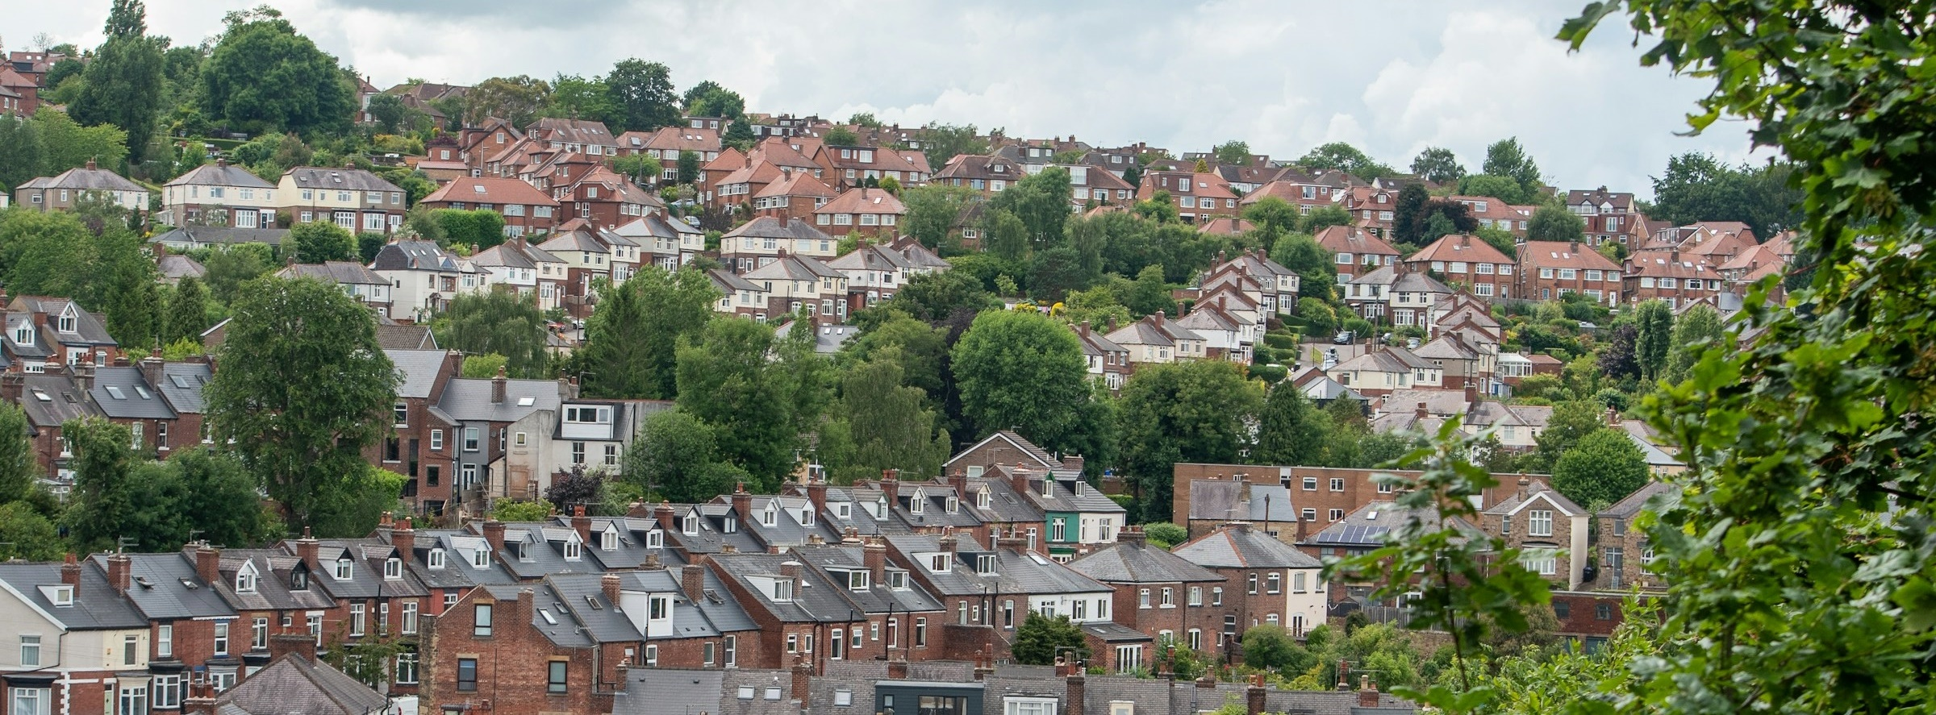
2
Why are we talking about this?
Many of us live in towns and cities. Our schools may be in the built-up areas near where we live. We share our built-up areas with other life too: animals, insects and plants.
Today we are going to be thinking about whether there is enough life in our built-up areas and if we want there to be more diversity.
At the end of the session, you will have a chance to vote on the question: “Would you like to see more wildlife brought into your built-up area?”
Notes:
Images
Unsplash +
Microsoft Fluent Emojis
References
https://www.votesforschools.com/

Slide 7
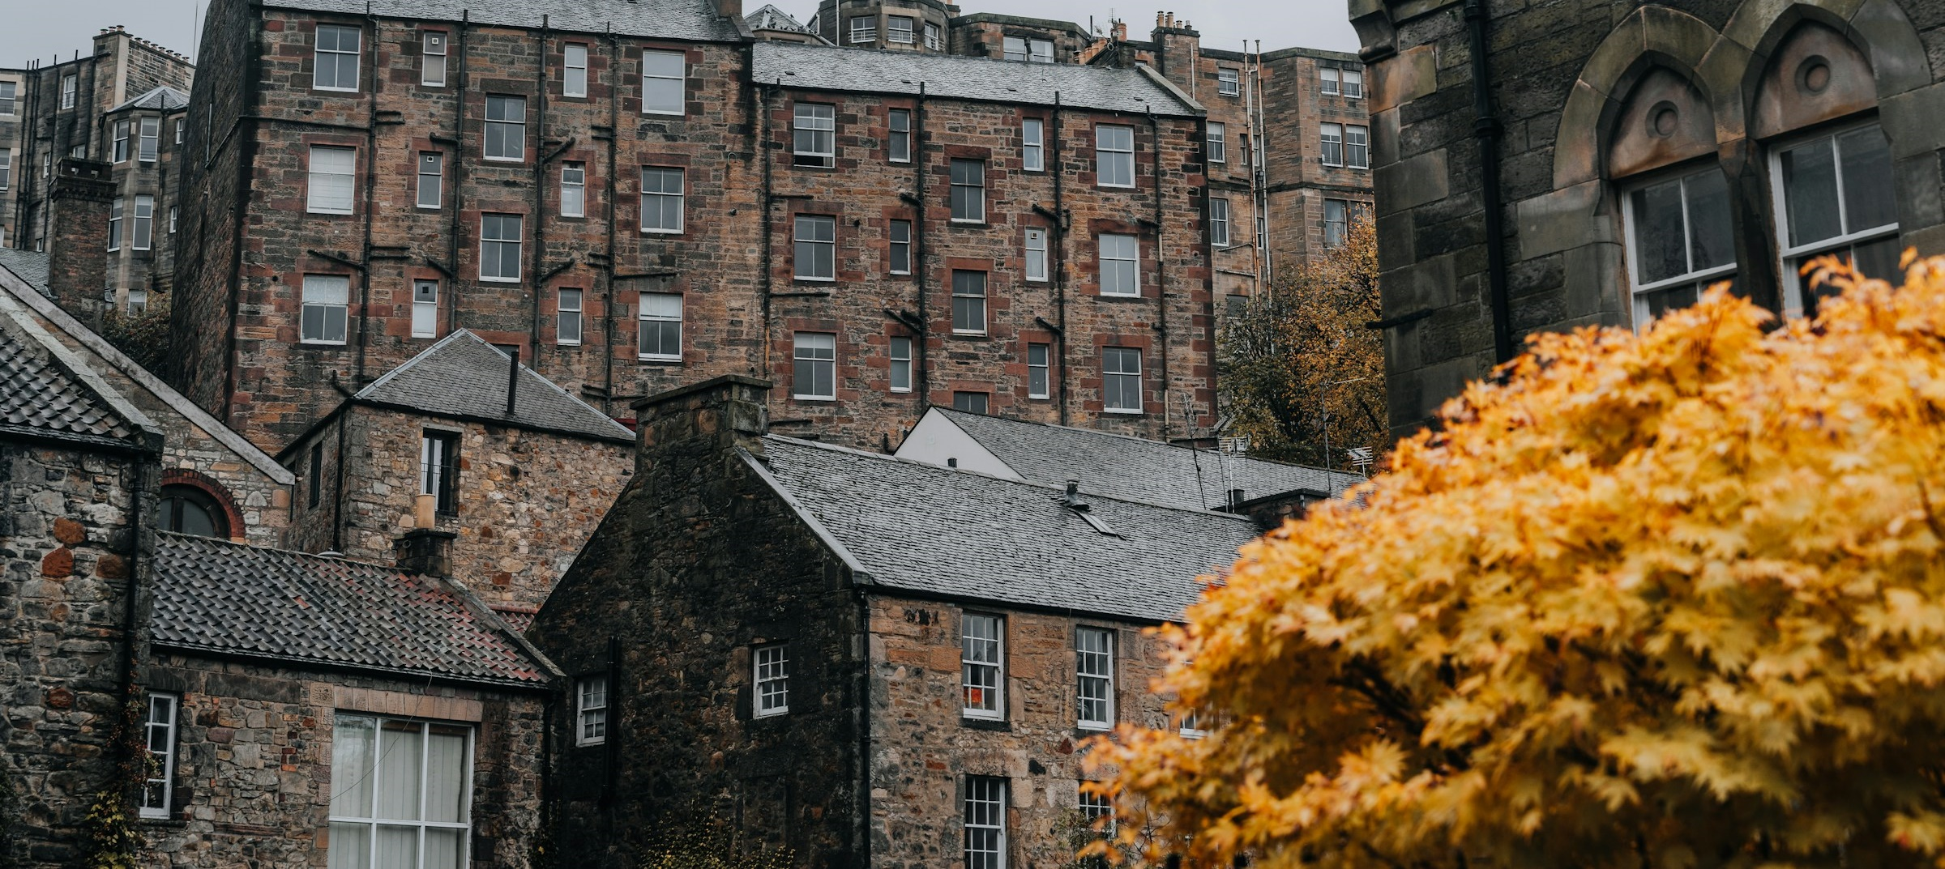
3
It’s wild out there
Up and down the country, there are individuals and groups working to make a difference by bringing nature into built-up areas.
Whole class activity (8-12 mins)
Suggest which words and phrases could complete the following examples of people working with nature.
Notes:
Images
Unsplash +

Slide 8
3
It’s wild out there
Plant lovers have been telling people ________________ weeds using chalk.
Notes:
Images
Unsplash +
References
https://www.theguardian.com/environment/2020/may/01/not-just-weeds-how-rebel-botanists-are-using-graffiti-to-name-forgotten-flora-aoe
https://www.positive.news/environment/more-than-weeds-the-rebel-botanists-on-a-mission-to-celebrate-urban-plants/

Slide 9
3
It’s wild out there
Plant lovers have been telling people ________________ weeds using chalk.
Plant lovers have been telling people the real names of weeds using chalk.
Notes:
Images
iStock
References
https://www.theguardian.com/environment/2020/may/01/not-just-weeds-how-rebel-botanists-are-using-graffiti-to-name-forgotten-flora-aoe
https://www.positive.news/environment/more-than-weeds-the-rebel-botanists-on-a-mission-to-celebrate-urban-plants/

Slide 10
3
It’s wild out there
A Hollywood-inspired bug hotel has been revealed in _______ . Local businesses, groups and schools were involved in making the sign.
A Hollywood-inspired bug hotel has been revealed in Farnham. Local businesses, groups and schools were involved in making the sign.
Notes:
Images
https://www.facebook.com/farnhamofficial
References
https://www.bbc.co.uk/news/articles/crg6ez9d9e7o

Slide 11
3
It’s wild out there
The Castlefield Viaduct has been transformed into a temporary green “______________” in the heart of Manchester.
Notes:
Images
Unsplash
https://commons.wikimedia.org/wiki/File:National_Trust_%27Sky_Park%27,_Castlefield_Viaduct,_Manchester_(geograph_7417617).jpg
References
https://www.nationaltrust.org.uk/visit/cheshire-greater-manchester/castlefield-viaduct

Slide 12
3
It’s wild out there
The Castlefield Viaduct has been transformed into a temporary green “______________” in the heart of Manchester.
The Castlefield Viaduct has been transformed into a temporary green “garden in the sky” in the heart of Manchester.
Notes:
Images
https://commons.wikimedia.org/wiki/File:National_Trust_%27Sky_Park%27,_Castlefield_Viaduct,_Manchester_(geograph_7417617).jpg
References
https://www.nationaltrust.org.uk/visit/cheshire-greater-manchester/castlefield-viaduct

Slide 13
3
It’s wild out there
New Street in Huddersfield now has three new 14-metre-tall white sculptures. They are designed for climbing _______________.
New Street in Huddersfield now has three new 14-metre-tall white sculptures. They are designed for climbing plants to be able to grow up.
Notes:
Images
Unsplash
References
https://www.examinerlive.co.uk/news/local-news/huge-huddersfield-white-planters-spark-27526938
https://www.bbc.co.uk/news/uk-england-leeds-66586175

Slide 14
3
It’s wild out there
On a former bit of wasteland in Birmingham, there is now a gardening club twice a month! This project started with volunteers digging and planting, then graffiti artists decorated the surrounding brick walls before a pond and a beehive were added to encourage more wildlife.
On a former bit of wasteland in Birmingham, there is now a ____________ twice a month! This project started with volunteers digging and planting, then graffiti artists decorated the surrounding brick walls before a pond and a beehive were added to encourage more wildlife.
Notes:
Images
Unsplash
References
https://www.birminghammail.co.uk/whats-on/family-kids-news/gallery/digbeth-community-garden-in-pictures-28755477

Slide 15
3
It’s wild out there
______ means “Dear Green Place”.
Since hosting the COP26 climate change conference, the city has been focusing on a project called People Make
______ Greener.
Glasgow means “Dear Green Place”. Since hosting the COP26 climate change conference, the city has been focusing on a project called People Make Glasgow Greener.
Notes:
Images
Unsplash
References
https://www.getreadyglasgow.com/greener

Slide 16
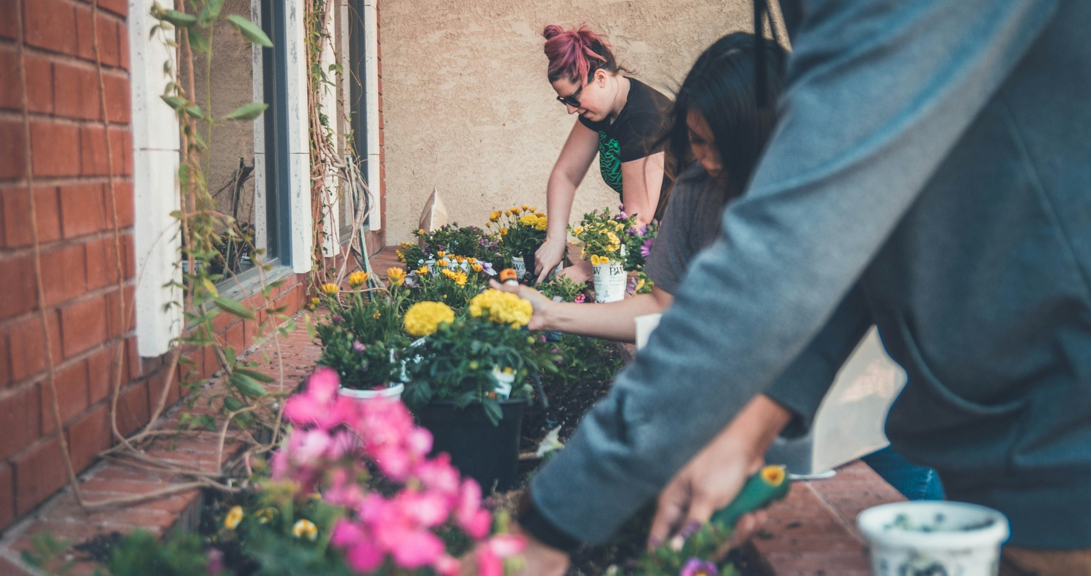
4
Paving the way
If we want our built-up areas to be wilder, how are we going to achieve it? We could act as individuals. Groups like politicians could act on a bigger scale.
Individual activity (6-12 mins)
You are about to read some
ideas about wildlife in our built-up areas. Which of the ideas do you agree with more? Give a hand gesture for your choice.
Notes:
Images
Unsplash +
Microsoft Fluent Emojis

Slide 17
4
Paving the way
If we want our built-up areas to be wilder, how are we going to achieve it? We could act as individuals. Groups like politicians could act on a bigger scale.
Individual activity (6-12 mins)
You are about to read some
ideas about wildlife in our built-up areas. Which of the ideas do you agree with more? Give a hand gesture for your choice.
Challenge (5-10 mins)
Do you have an alternative view to those shared? Share your thoughts with
the class.
Notes:
Images
Unsplash +
Microsoft Fluent Emojis

Slide 18
4
Paving the way
It’s amazing seeing wildlife anywhere, anytime.
I would rather see wildlife in their natural habitats, rather than sniffing around in rubbish.
Notes:
Images
Unsplash
Microsoft Fluent Emojis

Slide 19
4
Paving the way
Feeding wild animals in cities will encourage them to live there.
We don’t appreciate lots of the life we already have in cities. Where’s the love for pigeons?
Notes:
Images
Unsplash +
Microsoft Fluent Emojis

Slide 20
4
Paving the way
It might be safer for humans if wildlife stays away from built-up areas.
It might be safer for wildlife if they stay away from built-up areas.
Notes:
Images
Unsplash +
Microsoft Fluent Emojis

Slide 21
4
Paving the way
People are too focused on wanting to see mammals and birds. You need to start by bringing in more plant life.
I think people already appreciate plant life. Everyone likes to be able to sit on grass or walk under trees.
Notes:
Images
Unsplash +
Microsoft Fluent Emojis

Slide 22
4
Paving the way
People ignore that butterflies are insects and give us a free pass as we are nice to look at.
People need to get better with their fears and icks over insects. We are so important for healthy food chains.
Curriculum link – Biology
What keywords could describe the roles of insects in food chains and food webs?
Notes:
Images
Unsplash
Microsoft Fluent Emojis

Slide 23
4
Paving the way
Politicians are going to make the biggest difference, as they hear how much the public wants more life in built-up areas.
Hard work of volunteers improving chances for nature will make the biggest difference.
Notes:
Images
Unsplash +
Microsoft Fluent Emojis

Slide 24
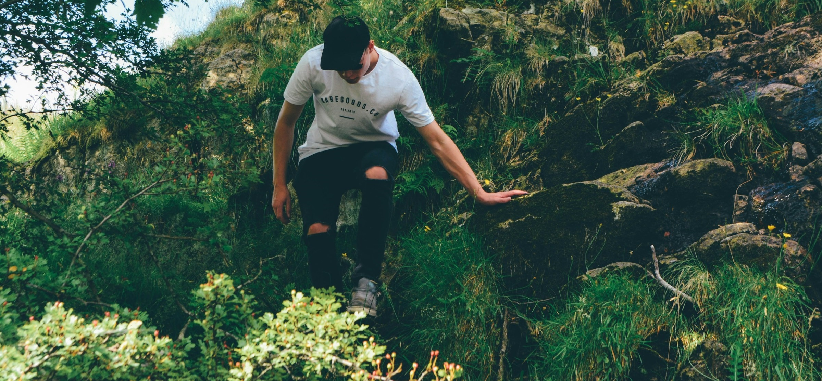
5
Taking a different root
We can take action as individuals and local communities to improve conditions for wildlife in our built-up areas. Larger organisations have been taking on big projects to rewild parts of the country.
Rewilding:
The process of protecting an environment and returning it to its natural state, for example by bringing back wild animals that used to live there.
Biodiversity:
The number and types of plants and animals that exist in a particular area.
Rewilding can help to improve the biodiversity in an area.
Notes:
Images
Unsplash
References
https://dictionary.cambridge.org/dictionary/english/rewilding
https://dictionary.cambridge.org/dictionary/english/biodiversity

Slide 25
5
Taking a different root
Challenge (2-3 mins)
Click this box to check out rewilding across the country. Use the map view to find the project that is closest to your school.
Notes:
Rewilding Britain Website: https://www.rewildingbritain.org.uk/rewilding-network/projects
Images
Unsplash
References
https://www.rewildingbritain.org.uk/rewilding-network/projects

Slide 26
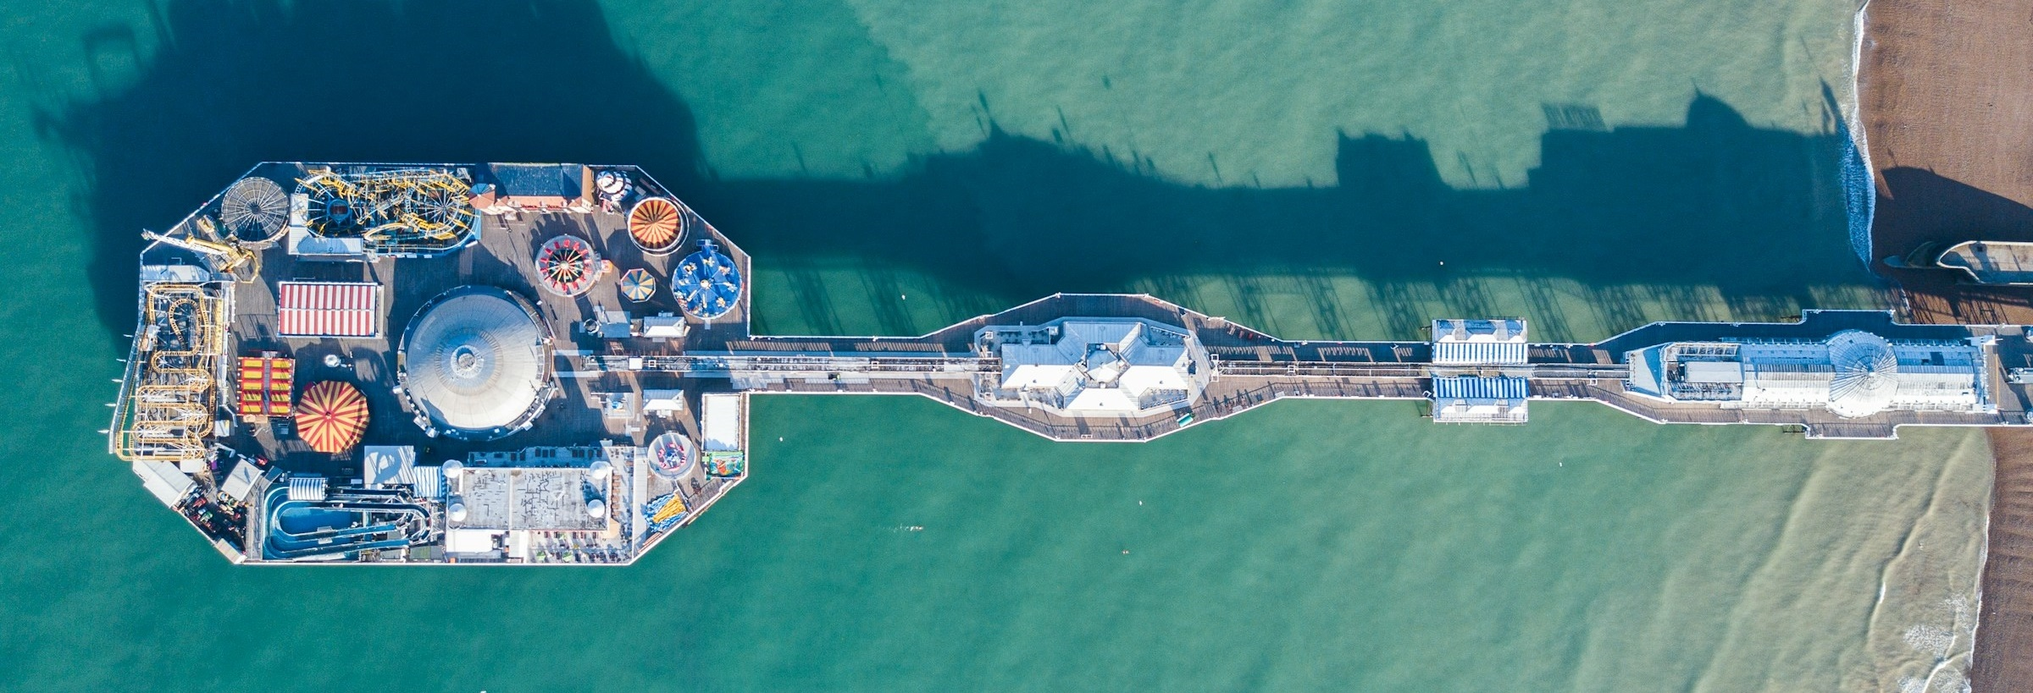
5
Taking a different root
Plans to improve wildlife in built-up areas can engage communities. Things will not always go to plan though. Brighton, on the south coast, is known for introducing green ideas. In 2019, its council voted to stop using a weedkiller that has links to causing cancer, and harming bee populations.
This month, the council voted to start using the weedkiller again. There was concern about the number of, and damage being caused by, weeds. Some people were concerned about accessibility on pavements. Some people have been concerned about the effects on wildlife by bringing back the weedkiller.
Notes:
Images
Unsplash
References
https://www.bbc.co.uk/news/articles/c7200ygq817o
https://www.bbc.co.uk/news/uk-england-sussex-68391002
https://www.bbc.co.uk/news/uk-england-sussex-67991852

Slide 27
5
Taking a different root
It’s a politician’s job to respond to local people’s wants and needs.
Individual activity (10-15 mins)
VotesforSchools and Eco-Schools will be sharing your views about wildlife with politicians across the country. Is there something in your area that could change? Make a plan to improve wildlife in a built-up area near you. What life would you like to see? What benefits could this bring?
Notes:
Images
Unsplash

Slide 28
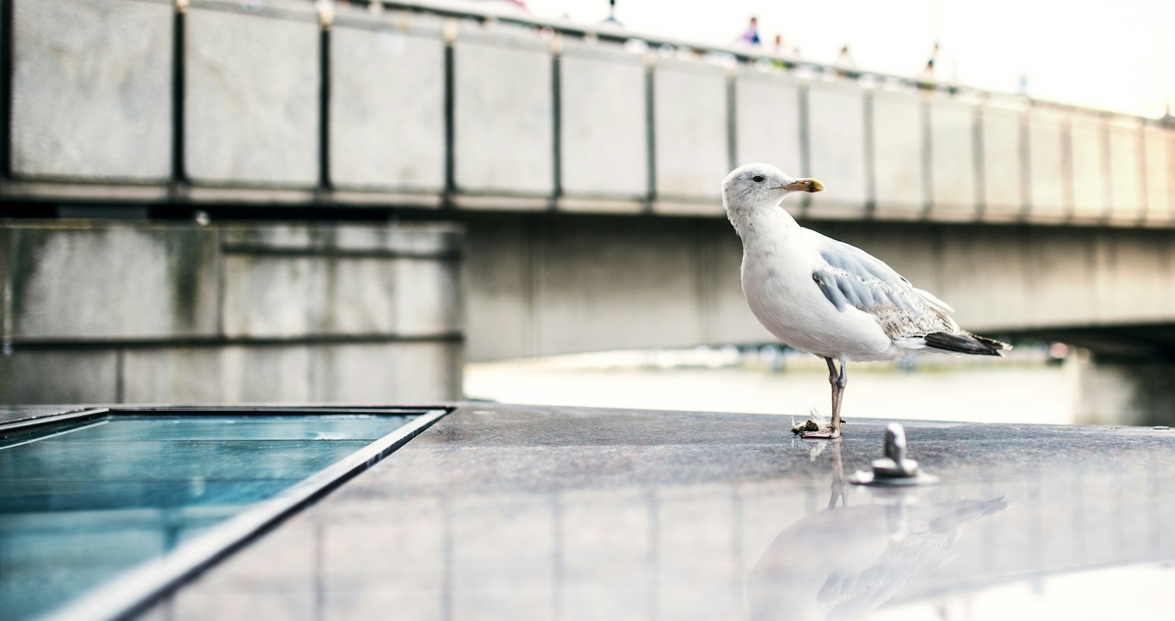
6
Sowing the seeds
At the end of today’s session, you will be voting Yes or No to the question: “Would you like to see more wildlife brought into your built-up area?”
Pair discussion (8-15 mins)
You are about to read some Yes and No comments about today’s topic. Do you agree with the opinion being shared? Has the comment influenced how you will vote today?
Notes:
Images
Unsplash +

Slide 29
6
Sowing the seeds
It’s a nice idea, but schemes like this cost a lot. Even if you have volunteers, the materials, tools and plants cost money.
No
Notes:
Images
Unsplash

Slide 30
6
Sowing the seeds
Yes
It’s more inviting when there is nature in built-up areas. It feels more peaceful, and you want to spend more time there.
Notes:
Images
Microsoft Office 365

Slide 31
6
Sowing the seeds
If you encourage too many animals into built-up areas, you may get competition between them.
No
Notes:
Images
Unsplash

Slide 32
6
Sowing the seeds
Yes
Every little plant pot makes a difference. Each new plant means food and shelter for more insects, and more insects means more food for animals.
Notes:
Images
Unsplash +

Slide 33
6
Sowing the seeds
There’s a fine line with rewilding. If you let things go, lots of weeds and grasses growing wherever can look scruffy.
No
Notes:
Images
Unsplash

Slide 34
6
Sowing the seeds
Yes
All habitats could do with some help. If your built-up area is by the coast, you can try to help by encouraging the nature that you find in the local area.
Notes:
Images
Unsplash

Slide 35
6
Sowing the seeds
Our built-up areas need to be accessible. It’s not fun for some people if trees and weeds have made the pavements unlevel. And what about hayfever sufferers?
No
Notes:
Images
Unsplash +

Slide 36
6
Sowing the seeds
Whole class discussion (4-6 mins)
Is it important for wildlife to be able to thrive in built-up areas?
Notes:
Images
Unsplash

Slide 37
Now’s your chance to vote on: “Would you like to see more wildlife brought into your built-up area?”
Yes
It’s more inviting when there is nature in built-up areas. It feels more peaceful, and you want to spend more time there.
Each new plant means food and shelter for more insects, and more insects means more food for animals.
All habitats could do with some help. If your built-up area is by the coast, you can try to help the nature that you find in the local area.
Schemes like this cost a lot. Even if you have volunteers, the materials, tools and plants cost money.
There’s a fine line with rewilding. If you let things go, lots of weeds and grasses growing wherever can look scruffy.
Our built-up areas need to be accessible. It’s not fun for some people if pavements are unlevel. And what about hayfever sufferers?
No
Ready to join the national conversation?
Please click here to cast votes and share views on this topic. Your opinions will then be passed on to decision-makers around the UK.
Notes:
Survey link: https://www.surveymonkey.com/r/VfS-Earth-Day-vote

