Slide 3
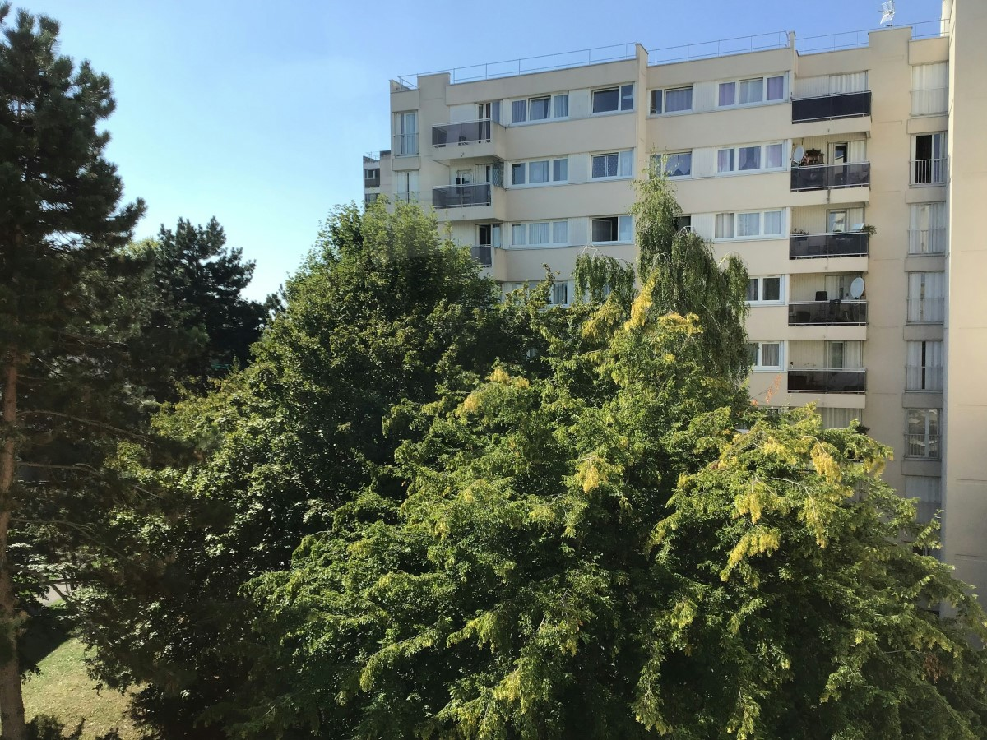
Today’s VoteTopic:
Would you like to see more wildlife brought into your built-up area?
UNCRC Article 24:
Health, water, food, environment
UN SDG 15:
Life on
land
VfS Key Theme 3:
Environment & climate change
Notes:
Images
Unsplash

Slide 4
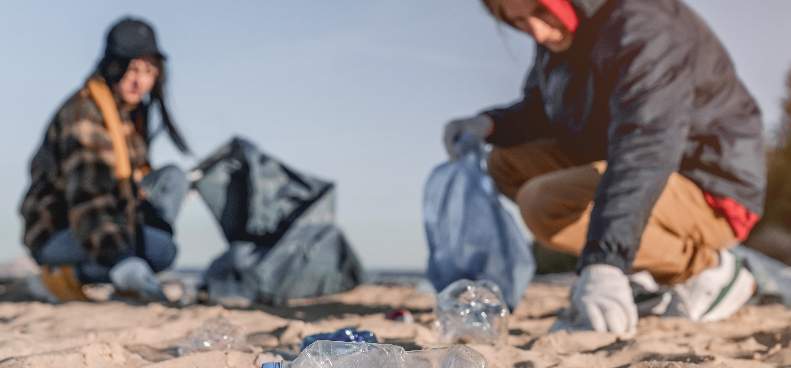
1
Why are we talking about this?
VotesforSchools has joined forces with Eco-Schools to support their Healthy Summer Toolkit.
This lesson gives you the chance to be heard by decision-makers from across the country! Let’s find out more about what you will be discussing today…
Notes:
Images
Microsoft Office 365
Courtesy of Eco-Schools
References
https://www.earthday.org/earth-day-2024/

Slide 5
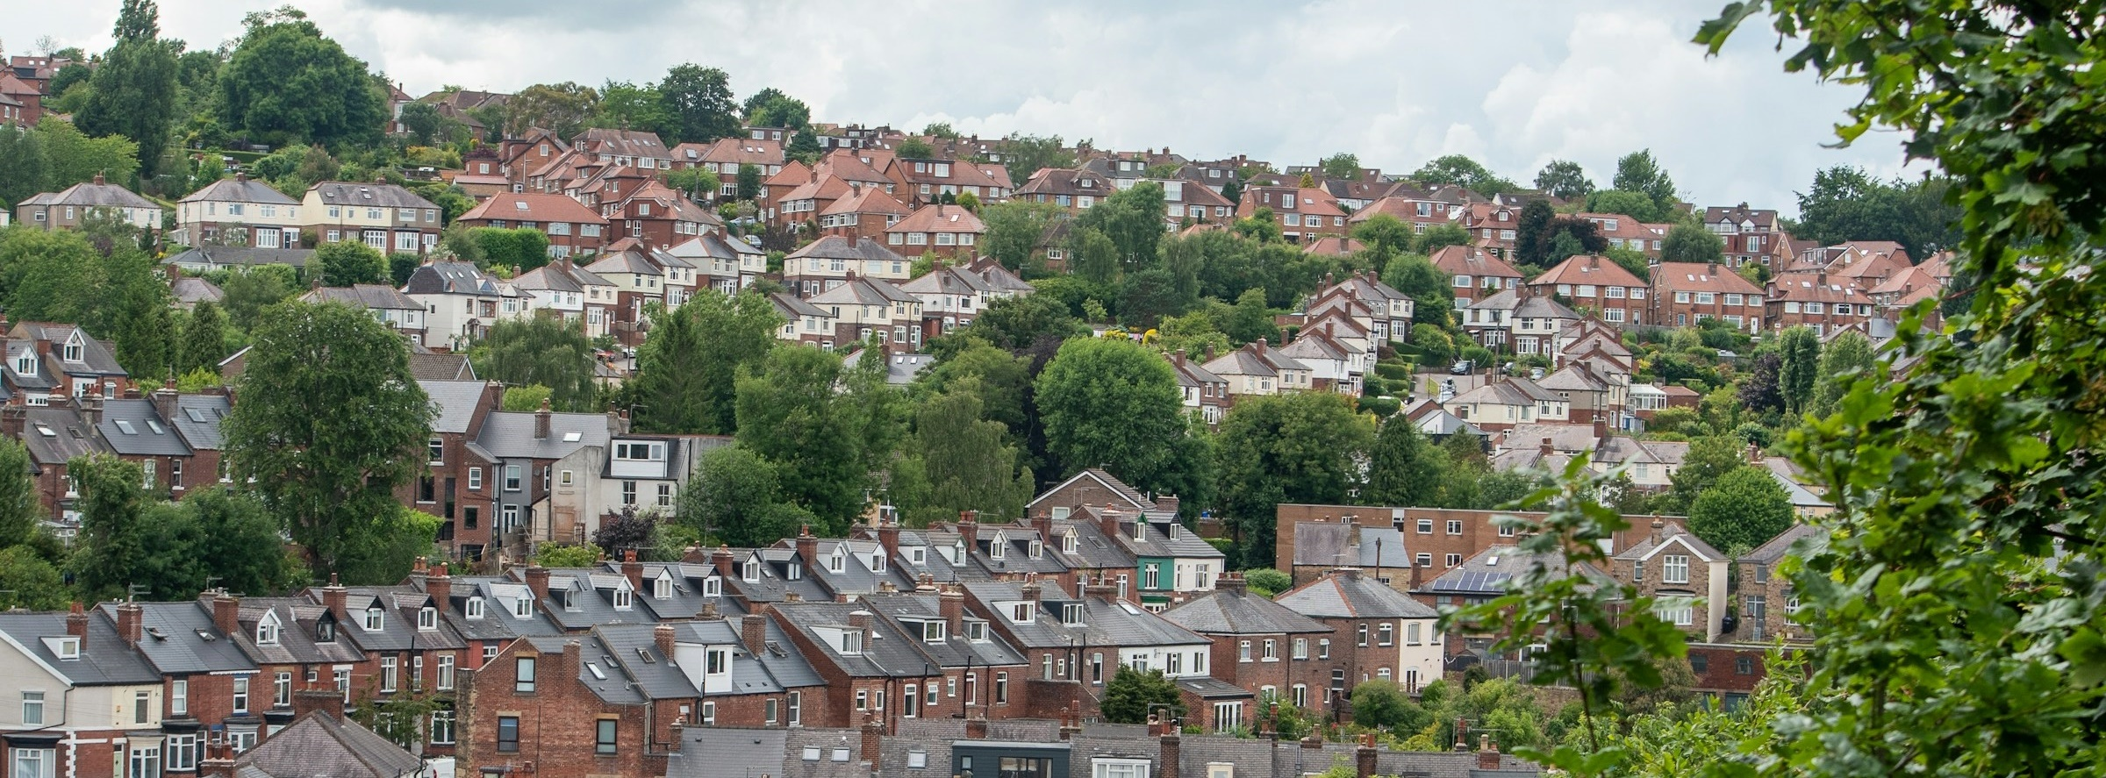
1
Why are we talking about this?
Many of us live in towns and cities. Our schools may be in the built-up areas near where we live. We share our built-up areas with other life too: animals, insects and plants.
Today we are going to be thinking about whether there is enough life in our built-up areas and if we want there to be more diversity.
At the end of the session, you will have a chance to vote on the question: “Would you like to see more wildlife brought into your built-up area?”
Notes:
Images
Unsplash +
Microsoft Fluent Emojis
References
https://www.votesforschools.com/

Slide 6
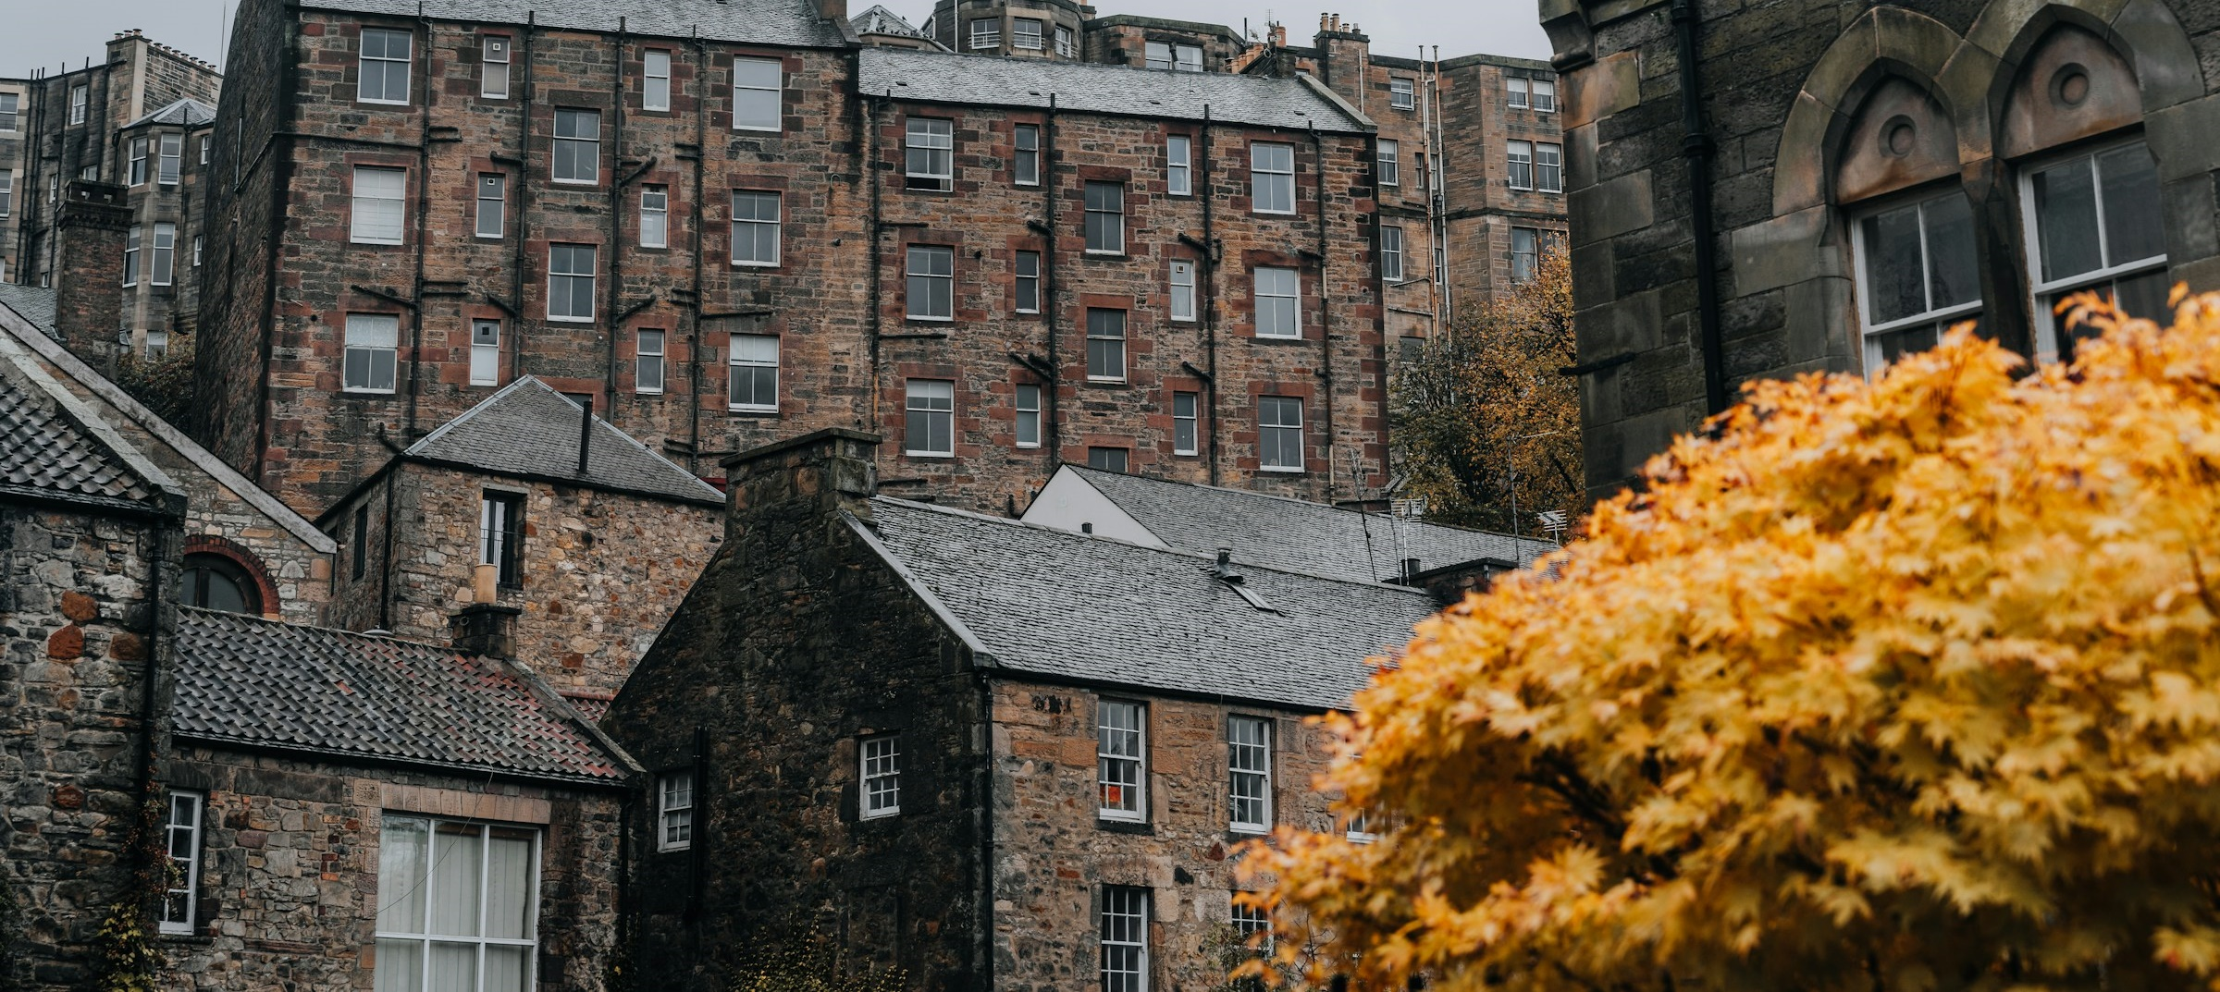
2
It’s wild out there
Up and down the country, there are individuals and groups working to make a difference by bringing nature into built-up areas.
Whole class activity (4-6 mins)
Suggest which words and phrases could complete the following examples of people working with nature.
Notes:
Images
Unsplash +

Slide 7
2
It’s wild out there
Plant lovers have been telling people ________________ weeds using chalk.
Notes:
Images
Unsplash +
References
https://www.theguardian.com/environment/2020/may/01/not-just-weeds-how-rebel-botanists-are-using-graffiti-to-name-forgotten-flora-aoe
https://www.positive.news/environment/more-than-weeds-the-rebel-botanists-on-a-mission-to-celebrate-urban-plants/

Slide 8
2
It’s wild out there
Plant lovers have been telling people ________________ weeds using chalk.
Plant lovers have been telling people the real names of weeds using chalk.
Notes:
Images
iStock
References
https://www.theguardian.com/environment/2020/may/01/not-just-weeds-how-rebel-botanists-are-using-graffiti-to-name-forgotten-flora-aoe
https://www.positive.news/environment/more-than-weeds-the-rebel-botanists-on-a-mission-to-celebrate-urban-plants/

Slide 9
2
It’s wild out there
The Castlefield Viaduct has been transformed into a temporary green “______________” in the heart of Manchester.
Notes:
Images
Unsplash
https://commons.wikimedia.org/wiki/File:National_Trust_%27Sky_Park%27,_Castlefield_Viaduct,_Manchester_(geograph_7417617).jpg
References
https://www.nationaltrust.org.uk/visit/cheshire-greater-manchester/castlefield-viaduct

Slide 10
2
It’s wild out there
The Castlefield Viaduct has been transformed into a temporary green “______________” in the heart of Manchester.
The Castlefield Viaduct has been transformed into a temporary green “garden in the sky” in the heart of Manchester.
Notes:
Images
https://commons.wikimedia.org/wiki/File:National_Trust_%27Sky_Park%27,_Castlefield_Viaduct,_Manchester_(geograph_7417617).jpg
References
https://www.nationaltrust.org.uk/visit/cheshire-greater-manchester/castlefield-viaduct

Slide 11
2
It’s wild out there
On a former bit of wasteland in Birmingham, there is now a gardening club twice a month! This project started with volunteers digging and planting, then graffiti artists decorated the surrounding brick walls before a pond and a beehive were added to encourage more wildlife.
On a former bit of wasteland in Birmingham, there is now a ____________ twice a month! This project started with volunteers digging and planting, then graffiti artists decorated the surrounding brick walls before a pond and a beehive were added to encourage more wildlife.
Notes:
Images
Unsplash
References
https://www.birminghammail.co.uk/whats-on/family-kids-news/gallery/digbeth-community-garden-in-pictures-28755477

Slide 12
2
It’s wild out there
______ means “Dear Green Place”.
Since hosting the COP26 climate change conference, the city has been focusing on a project called People Make
______ Greener.
Glasgow means “Dear Green Place”. Since hosting the COP26 climate change conference, the city has been focusing on a project called People Make Glasgow Greener.
Notes:
Images
Unsplash
References
https://www.getreadyglasgow.com/greener

Slide 13
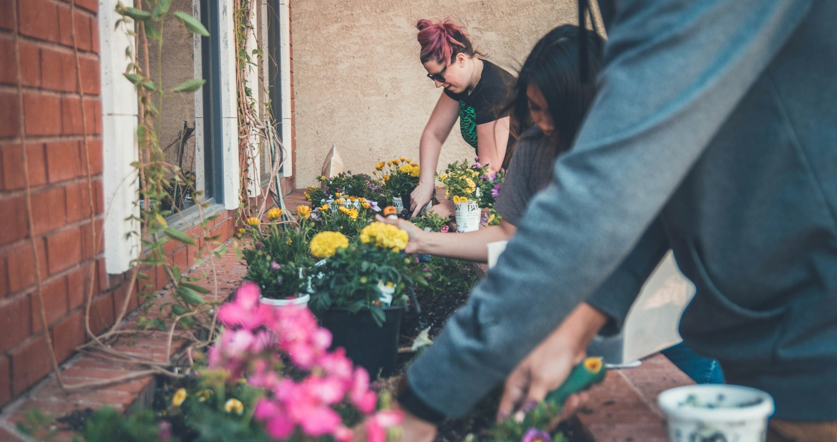
3
Paving the way
If we want our built-up areas to be wilder, how are we going to achieve it? We could act as individuals. Groups like politicians could act on a bigger scale.
Individual activity (4-8 mins)
You are about to read some
ideas about wildlife in our built-up areas. Which of the ideas do you agree with more? Give a hand gesture for your choice.
Notes:
Images
Unsplash +
Microsoft Fluent Emojis

Slide 14
3
Paving the way
It’s amazing seeing wildlife anywhere, anytime.
I would rather see wildlife in their natural habitats, rather than sniffing around in rubbish.
Notes:
Images
Unsplash
Microsoft Fluent Emojis

Slide 15
3
Paving the way
Feeding wild animals in cities will encourage them to live there.
We don’t appreciate lots of the life we already have in cities. Where’s the love for pigeons?
Notes:
Images
Unsplash +
Microsoft Fluent Emojis

Slide 16
3
Paving the way
People are too focused on wanting to see mammals and birds. You need to start by bringing in more plant life.
I think people already appreciate plant life. Everyone likes to be able to sit on grass or walk under trees.
Notes:
Images
Unsplash +
Microsoft Fluent Emojis

Slide 17
3
Paving the way
Politicians are going to make the biggest difference, when they hear how much the public wants more life in built-up areas.
Hard work of volunteers improving chances for nature will make the biggest difference.
Notes:
Images
Unsplash +
Microsoft Fluent Emojis

Slide 18
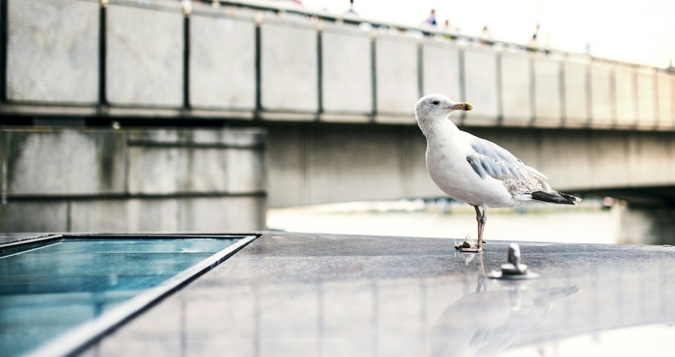
4
Sowing the seeds
At the end of today’s session, you will be voting Yes or No to the question: “Would you like to see more wildlife brought into your built-up area?”
Pair discussion (5-8 mins)
You are about to read some Yes and No comments about today’s topic. Do you agree with the opinion being shared? Has the comment influenced how you will vote today?
Notes:
Images
Unsplash +

Slide 19
4
Sowing the seeds
It’s a nice idea, but schemes like this cost a lot. Even if you have volunteers, the materials, tools and plants cost money.
No
Notes:
Images
Unsplash

Slide 20
4
Sowing the seeds
Yes
It’s more inviting when there is nature in built-up areas. It feels more peaceful, and you want to spend more time there.
Notes:
Images
Microsoft Office 365

Slide 21
4
Sowing the seeds
There’s a fine line with rewilding. If you let things go, lots of weeds and grasses growing wherever can look scruffy.
No
Rewilding:
The process of protecting an environment and returning it to its natural state, for example by bringing back wild animals that used to live there.
Notes:
Images
Unsplash
References
https://dictionary.cambridge.org/dictionary/english/rewilding

Slide 22
4
Sowing the seeds
Yes
Every little plant pot makes a difference. Each new plant means food and shelter for more insects, and more insects means more food for animals.
Notes:
Images
Unsplash +

Slide 23
4
Sowing the seeds
Our built-up areas need to be accessible. It’s not fun for some people if trees or weeds have made the pavements unlevel. And what about hayfever sufferers?
No
Notes:
Images
Unsplash +

Slide 24
4
Sowing the seeds
Individual reflection (1-2 mins)
Is it important for wildlife to be able to thrive in built-up areas?
Notes:
Images
Unsplash

Slide 25
Now’s your chance to vote on: “Would you like to see more wildlife brought into your built-up area?”
Yes
It’s more inviting when there is nature in built-up areas. It feels more peaceful, and you want to spend more time there.
Each new plant means food and shelter for more insects, and more insects means more food for animals.
All habitats could do with some help. If your built-up area is by the coast, you can try to help the nature that you find in the local area.
Schemes like this cost a lot. Even if you have volunteers, the materials, tools and plants cost money.
There’s a fine line with rewilding. If you let things go, lots of weeds and grasses growing wherever can look scruffy.
Our built-up areas need to be accessible. It’s not fun for some people if pavements are unlevel. And what about hayfever sufferers?
No
Ready to join the national conversation?
Please click here to cast votes and share views on this topic. Your opinions will then be passed on to decision-makers around the UK.
Notes:
Survey link: https://www.surveymonkey.com/r/VfS-Earth-Day-vote

