Slide 3
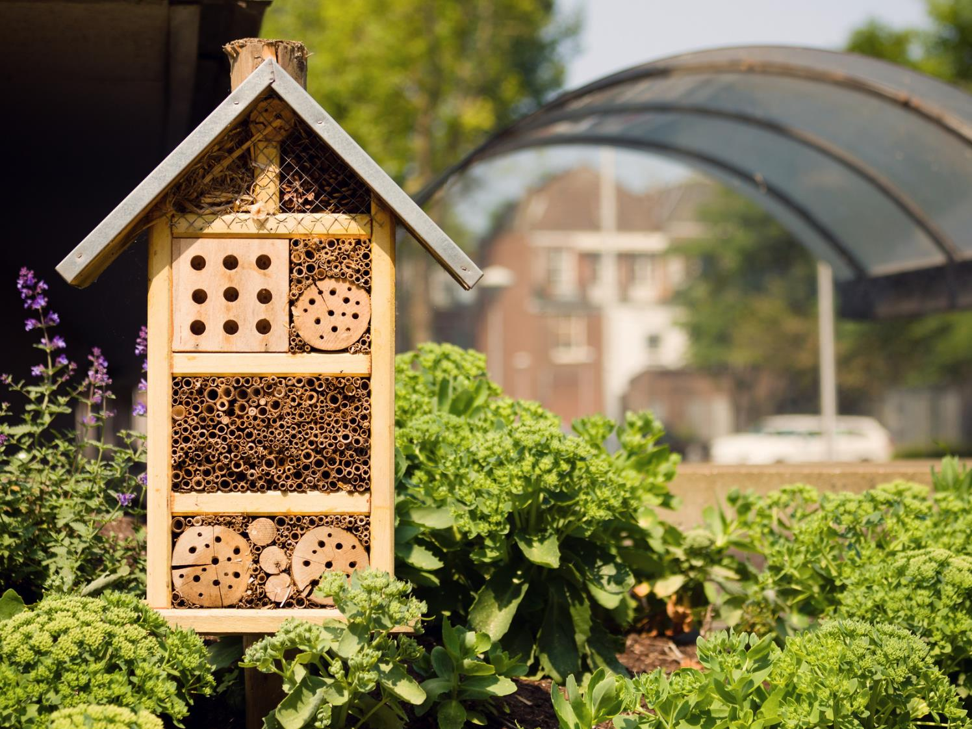
Today’s VoteTopic:
Would you like to see more wildlife in your towns and cities?
UNCRC Article 24:
Health, water, food, environment
UN SDG 15:
Life on
land
VfS Key Theme 3:
Environment & climate change
Notes:
Images
iStock

Slide 4
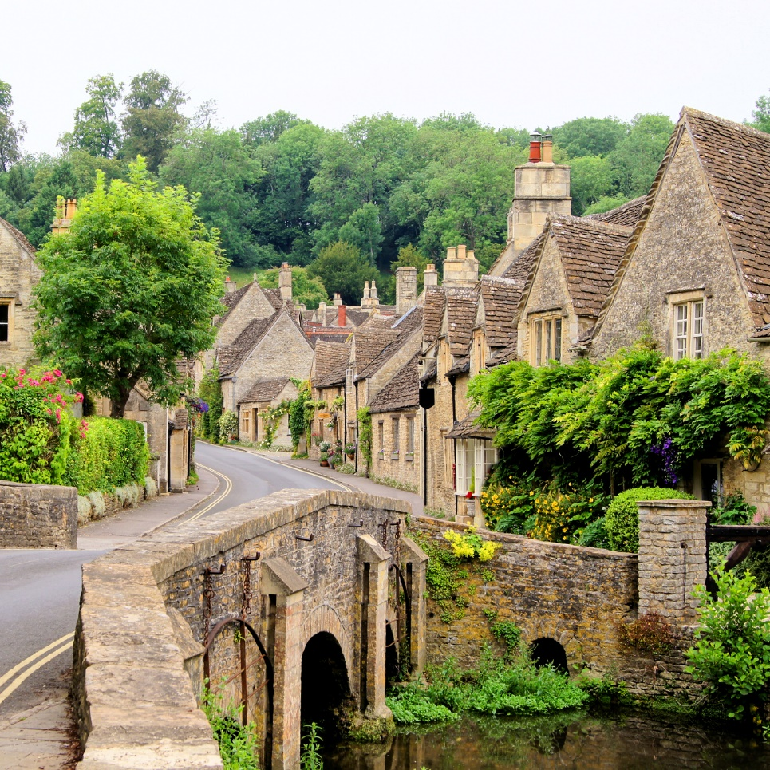
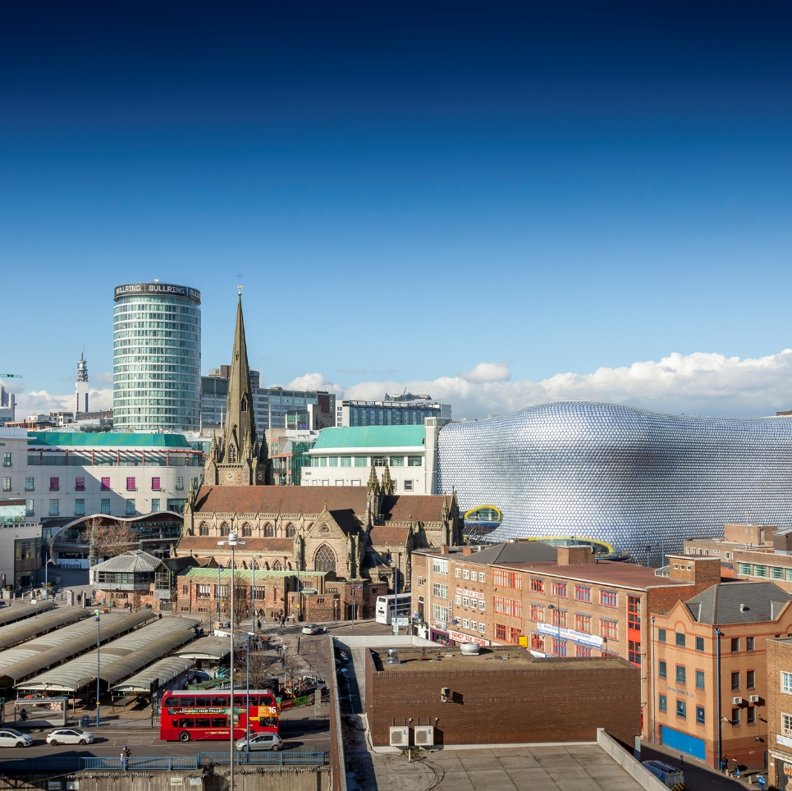
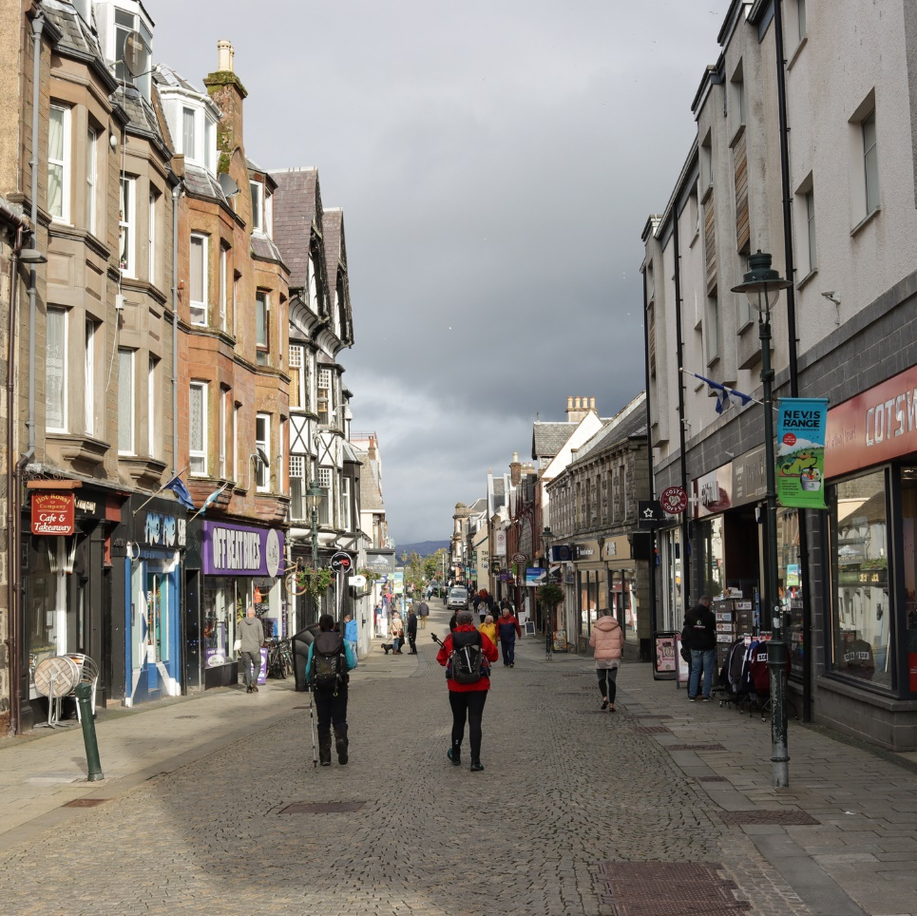
1
What’s the difference?
Whole class activity (4-5 mins)
Click the play button to watch a video. After watching it, can you explain the difference between a village, a town and a city?
3:14
Village
City
Town
Notes:
SafeShare Link: https://www.bbc.co.uk/teach/class-clips-video/geography-ks1--ks2-cities-towns-villages/zjn492p#:~:text=A%20town%20is%20a%20larger,And%20often%20a%20town%20hall. (0:00-3:14) YouTube Link: https://www.youtube.com/watch?v=EUv2lD7031c (0:00-3:14)
Images
iStock
Microsoft Office 365

Slide 5
2
Why are we talking about this?
VotesforSchools has teamed up with Eco-Schools to support their Healthy Summer Toolkit.
This lesson gives you the chance to be heard by decision-makers across the UK! Let’s find out more about what you will be exploring today…
Notes:
Images
iStock
Courtesy of Eco-Schools
References
https://www.earthday.org/

Slide 6
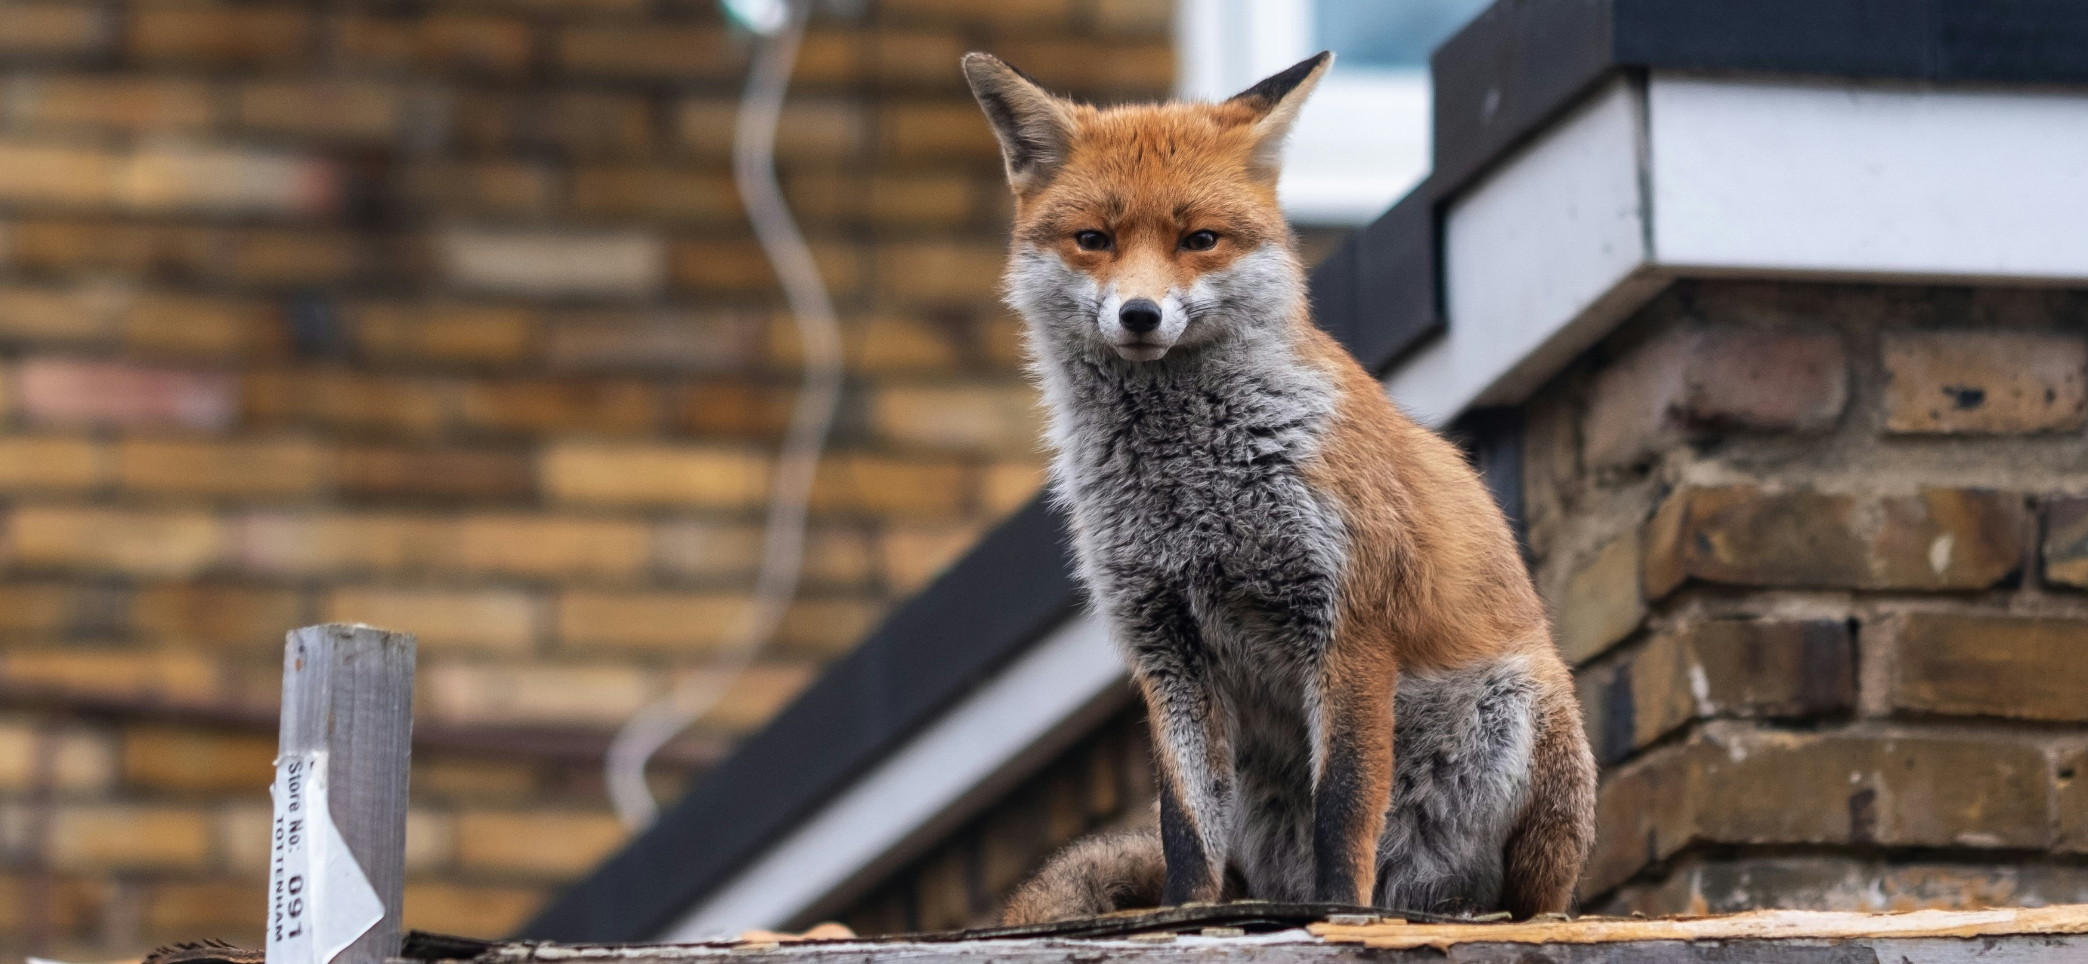
2
Why are we talking about this?
Many of us live in towns and cities. Our schools might be in the built-up areas near to where we live.
Curriculum link – Science
Are foxes herbivores, omnivores or carnivores?
However, it is not just humans who live in towns and cities. We share these spaces with other wildlife like animals, insects and plants.
Notes:
Images
Unsplash
References
https://www.woodlandtrust.org.uk/blog/2019/08/what-foxes-eat/

Slide 7
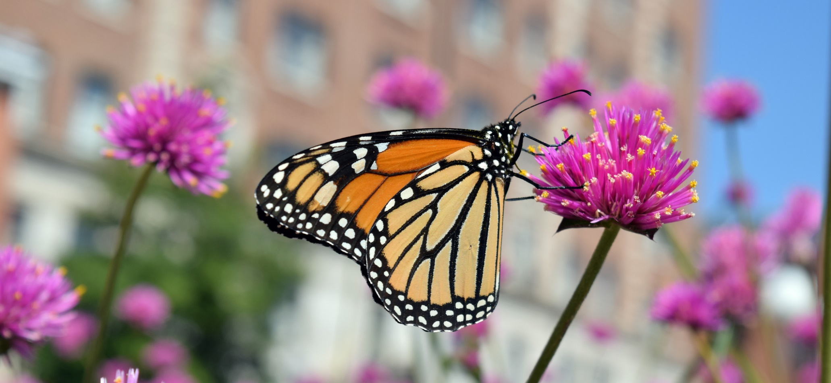
2
Why are we talking about this?
There are lots of different kinds of wildlife that have learned to live alongside humans in the hidden corners of towns and cities across the UK.
But is there enough? Would you like to see more wildlife in your towns and cities? Let’s decide today.
Notes:
Images
iStock
References
https://www.wildlifetrusts.org/where_to_see_urban_wildlife

Slide 8
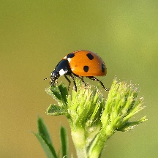
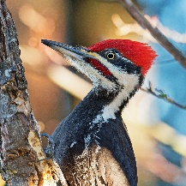
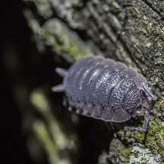
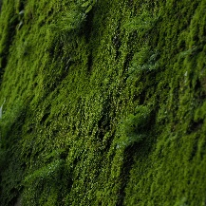
3
It’s wild out there…
Pair activity (4-6 mins)
All living things on our planet are connected. Now we’re going to think about a single tree and the different life forms that interact with it.
Talk to your partner to share your ideas about the role of each living thing under the magnifying glass.
Trees are home to a lot of living things.
Lots of these creatures depend on each other…
Notes:
Images
Unsplash
Microsoft Office 365
Pixabay

Slide 9
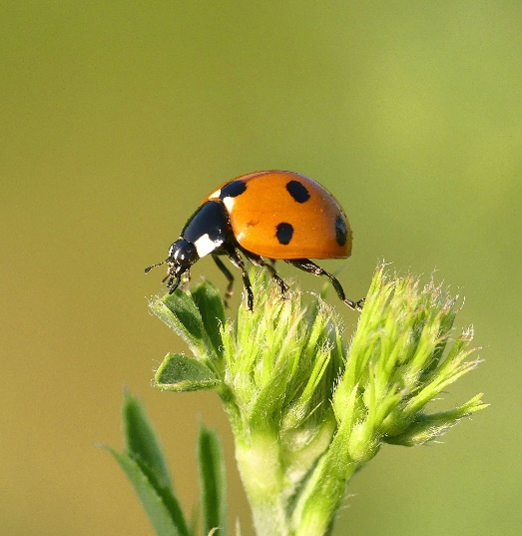
3
It’s wild out there…
Did you know?
There are 46 species of ladybird in the UK.
How does a ladybird interact with a tree?
Interact:
Two or more things that support each other.
A ladybird eats small insects which feed on tree leaves. It also lays eggs on there.
Notes:
Images
Unsplash
Pixabay
References
https://www.coleoptera.org.uk/coccinellidae/lots-about
https://dictionary.cambridge.org/dictionary/english/interact

Slide 10
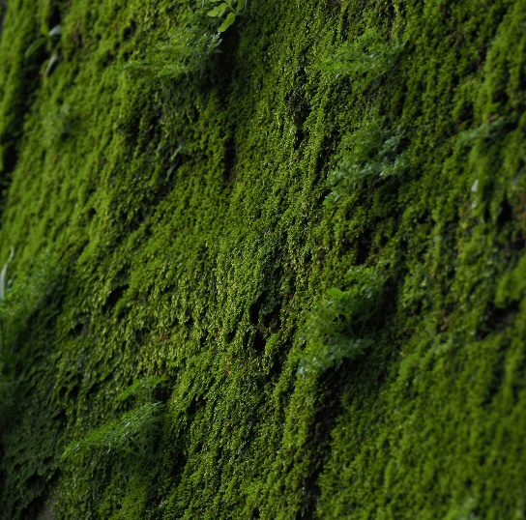
3
It’s wild out there…
Moss is a bit like a sponge. It helps to soak up rainfall and allows other plants to grow.
How does moss interact with a tree?
Notes:
Images
Unsplash
Pixabay
References
https://www.kew.org/read-and-watch/moss

Slide 11
3
It’s wild out there…
How does a woodpecker interact with a tree?
The woodpecker eats insects including ladybirds and woodlice. That’s a bit greedy if you ask me!
Notes:
Images
Unsplash
Pixabay
References
https://www.wildlifetrusts.org/where-see-wildlife/where-see-spring-wildlife/woodpeckers

Slide 12
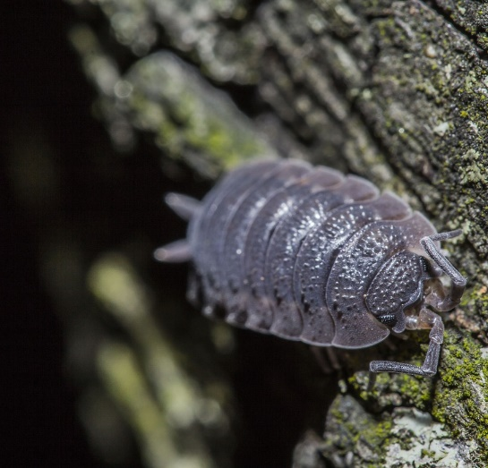
3
It’s wild out there…
How does a woodlouse interact with a tree?
Woodlice feed on leaf litter, fungi, fallen fruit and dead animals. They are also important for compost heaps!
Notes:
Images
Unsplash
Pixabay
References
https://www.discoverwildlife.com/animal-facts/insects-invertebrates/facts-about-common-rough-woodlouse

Slide 13
3
It’s wild out there…
How does a human interact with a tree?
Humans use trees for shelter and shade. They also use the wood to make timber, paper and cardboard.
Notes:
Images
Microsoft Office 365
Pixabay

Slide 14
4
Creating a buzz
Whole class activity (5-10 mins)
Over the next few slides, you will read some facts about wildlife in the UK.
For each one, do an impression of the insect that you think is correct.
Notes:
Images
iStock
Microsoft Fluent Emoji

Slide 15
4
Creating a buzz
70,000
60,000
80,000
The UK has more than _____ known types of wildlife.
The UK has more than 70,000 known types of wildlife.
Notes:
Images
iStock
Microsoft Fluent Emoji
References
https://royalsociety.org/news-resources/projects/biodiversity/biodiversity-in-the-uk/

Slide 16
4
Creating a buzz
40%
60%
20%
In the UK, there is ___ less wildlife than there was 44 years ago.
In the UK, there is 20% less wildlife than there was 44 years ago.
Notes:
Images
iStock
Microsoft Fluent Emoji
References
https://stateofnature.org.uk/wp-content/uploads/2023/09/TP25999-State-of-Nature-main-report_2023_FULL-DOC-v12.pdf

Slide 17
4
Creating a buzz
50
100
25
Manchester opened its first city centre park in ____ years.
Manchester opened its first city centre park in 100 years.
Notes:
Images
iStock
Microsoft Fluent Emoji
References
https://www.theguardian.com/uk-news/2022/sep/22/manchester-park-opens-delighting-kids-kingfishers-mayfield

Slide 18
4
Creating a buzz
two
three
one
Extinct:
When a type of wildlife no longer exists.
Nearly one in six species are at risk of becoming
extinct in Great Britain.
Nearly ____ in six species are at risk of becoming extinct in Great Britain.
Notes:
Images
iStock
Microsoft Fluent Emoji
References
https://stateofnature.org.uk/wp-content/uploads/2023/09/TP25999-State-of-Nature-main-report_2023_FULL-DOC-v12.pdf
https://dictionary.cambridge.org/dictionary/learner-english/extinct

Slide 19
4
Creating a buzz
12,000
10,000
14,000
Over ___ different types of wildlife have been recorded in London.
Over 14,000 different types of wildlife have been recorded in London.
Notes:
Images
iStock
Microsoft Fluent Emoji
References
https://www.london.gov.uk/programmes-strategies/environment-and-climate-change/parks-green-spaces-and-biodiversity/biodiversity

Slide 20
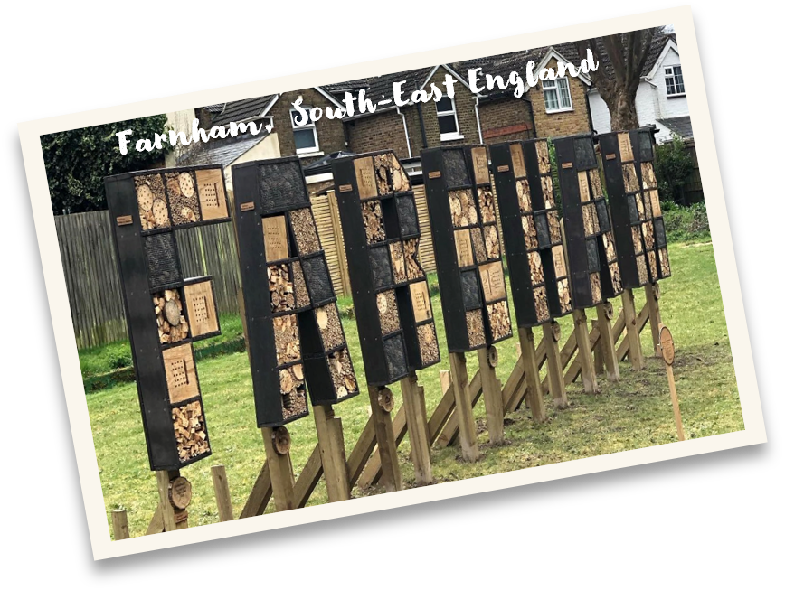
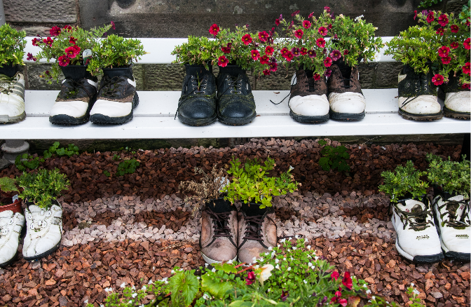
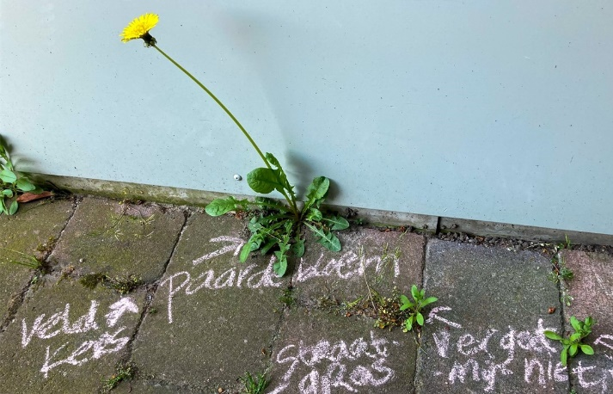
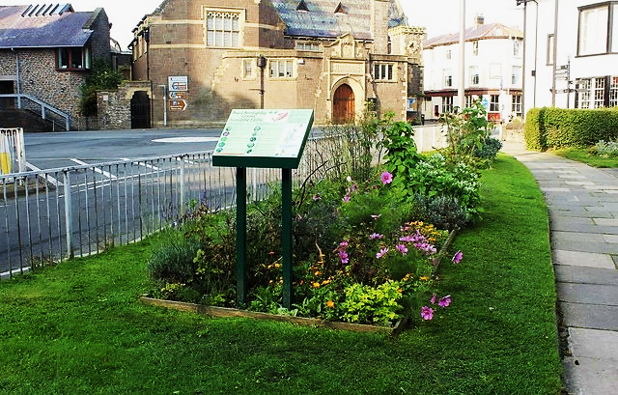
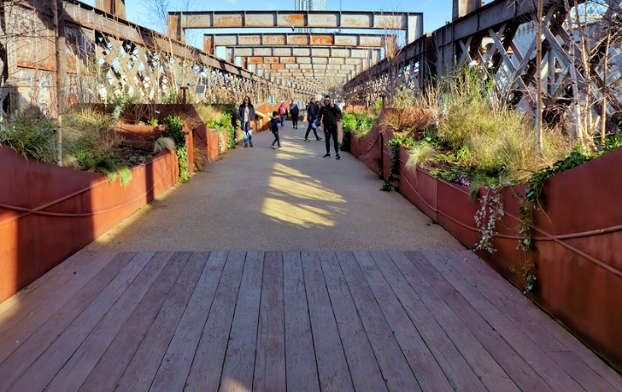
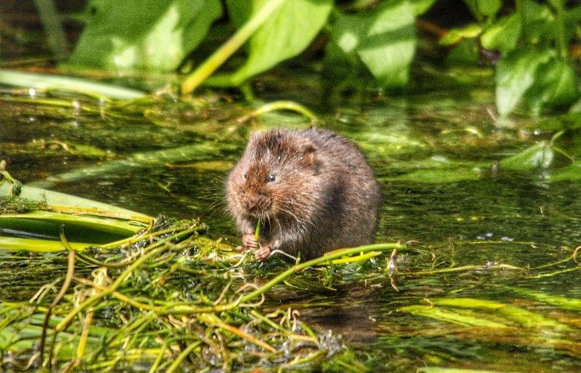
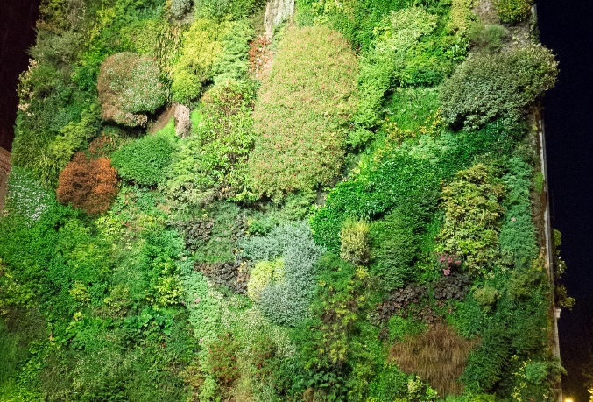
5
BiodiverCITIES
Pair activity (7-10 mins)
On the next few slides, you will see some examples where citizens are finding small ways to increase the amount of wildlife in towns and cities all over the UK. Talk to your partner about where you think there could be space for each example in your local town or city.
LONDON
SOUTH ENGLAND
Crediton, South-West England
Newcastle, North-East England
Glasgow
West Scotland
Conwy, north wales
Manchester
North-West England
Notes:
Images
Unsplash
iStock
https://www.facebook.com/farnhamofficial
Canva
https://commons.wikimedia.org/wiki/File:Incredible_edible_-_geograph.org.uk_-_5552099.jpg
https://commons.wikimedia.org/wiki/File:National_Trust_%27Sky_Park%27,_Castlefield_Viaduct,_Manchester_(geograph_7417617).jpg
https://upload.wikimedia.org/wikipedia/commons/c/cd/Living_wall_%2818653257555%29.jpg

Slide 21
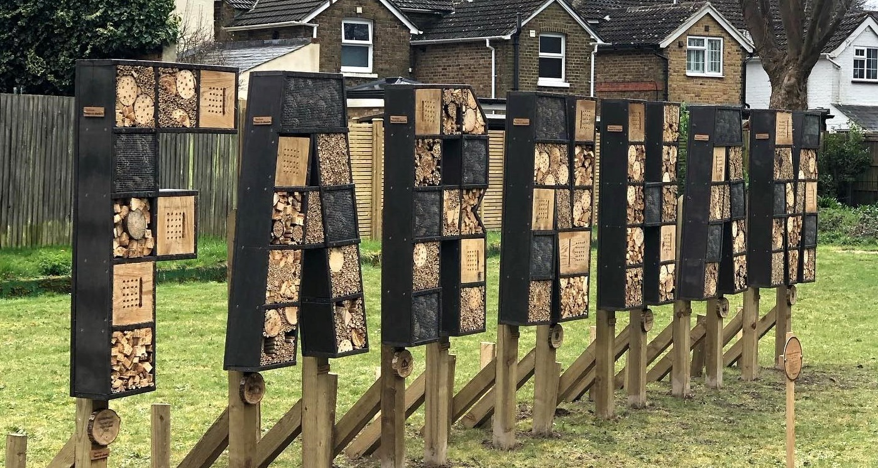
5
BiodiverCITIES
Farnham, South-East England
Where is there space for this in your local town or city?
Farnham Town
Council has
created a bug hotel
which spells out
the name of the
town. Bug hotels
can help increase
the number of
insects.
Mayor of Greater
Manchester,
56 Oxford Street,
MANCHESTER.
Notes:
Images
Unsplash
iStock
Canva
https://www.facebook.com/farnhamofficial
References
https://www.bbc.co.uk/news/articles/crg6ez9d9e7o
https://www.greatermanchester-ca.gov.uk/contact/

Slide 22
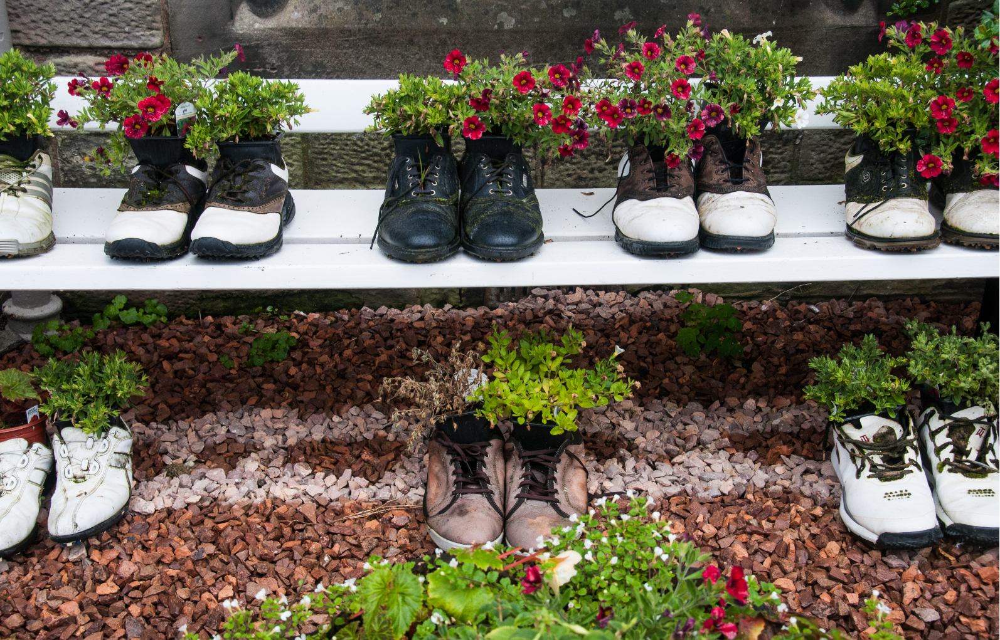
5
BiodiverCITIES
Where is there space for this in your local town or city?
Hayward
Primary School
in Crediton has
made planters out
of old shoes,
which they grow
flowering plants
in to encourage
insect life at their
school.
Crediton, South-West England
Mayor of Leeds,
1st Floor West,
Civic Hall,
LEEDS.
Notes:
Images
Unsplash
iStock
Canva
References
https://www.creditoncourier.co.uk/news/recycled-shoe-planters-will-brighten-haywards-school-grounds-623236
https://www.leeds.gov.uk/councillors-and-democracy/lord-mayor

Slide 23
5
BiodiverCITIES
Where is there space for this in your local town or city?
A business
called Incredible
Edible has a
group in Conwy
that has made
flower, herb,
fruit and
vegetable beds in
patches all over
the town.
Conwy, North Wales
Mayor of
Nottingham,
Council House,
NOTTINGHAM.
Notes:
Images
Unsplash
iStock
Canva
https://commons.wikimedia.org/wiki/File:Incredible_edible_-_geograph.org.uk_-_5552099.jpg
References
https://www.incredibleedible.org.uk/what-we-d
https://www.nottinghamcity.gov.uk/your-council/about-the-council/councillors-and-leadership/the-lord-mayor-of-nottingham/o/

Slide 24
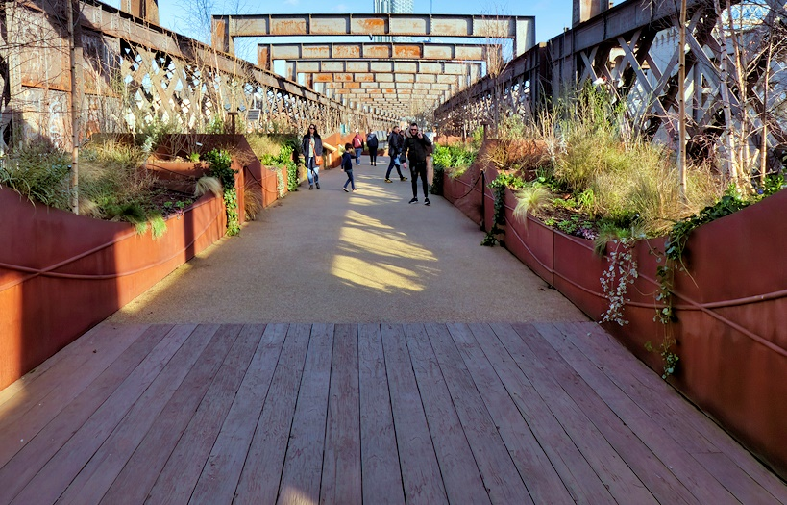
5
BiodiverCITIES
Where is there space for this in your local town or city?
An unused
railway bridge
in Manchester
(Castlefield
Viaduct) has been
turned into a
city garden space
to increase
wildlife in the
city.
Manchester
North-West England
Mayor of London,
City Hall,
Kamal Chunchie Way,
LONDON.
Notes:
Images
Unsplash
iStock
Canva
https://commons.wikimedia.org/wiki/File:National_Trust_%27Sky_Park%27,_Castlefield_Viaduct,_Manchester_(geograph_7417617).jpg
References
https://www.nationaltrust.org.uk/visit/cheshire-greater-manchester/castlefield-viaduct
https://www.london.gov.uk/who-we-are/what-mayor-does/contact-city-hall-or-mayor

Slide 25
5
BiodiverCITIES
LONDON
SOUTH ENGLAND
Where is there space for this in your local town or city?
Plant lovers
in London have
been telling
people the real
names of plants
on the streets
using chalk to
change people’s
minds about
weeds.
Mayor of Cardiff,
County Hall,
Atlantic Wharf,
CARDIFF.
Notes:
Images
Unsplash
iStock
Canva
References
https://www.theguardian.com/environment/2020/may/01/not-just-weeds-how-rebel-botanists-are-using-graffiti-to-name-forgotten-flora-aoe
https://www.cardiff.gov.uk/ENG/Home/Contact-us/General-enquiries/Pages/default.aspx

Slide 26
5
BiodiverCITIES
Glasgow
West Scotland
Where is there space for this in your local town or city?
Glasgow’s
Local Biodiversity
Action Plan aims
to protect and
grow the habitats
of animals that
are common
there, for
example water
voles.
Mayor of Liverpool,
No 1 Mann Island,
Did you know?
Glasgow means “Dear Green Place” in Celtic.
LIVERPOOL.
Notes:
Images
Unsplash
iStock
Canva
References
https://www.glasgow.gov.uk/CHttpHandler.ashx?id=31719&p=0
https://www.liverpoolcityregion-ca.gov.uk/contact

Slide 27
5
BiodiverCITIES
Newcastle, North-East England
Where is there space for this in your local town or city?
In Newcastle,
there is a living
wall of plants
growing on the
side of a
supermarket
building to
increase plant and
insect life in a
vertical space.
Mayor of Exeter,
Curriculum link – Maths
What does vertical mean?
Civic Centre,
Paris Street,
EXETER.
Notes:
Images
Unsplash
iStock
https://upload.wikimedia.org/wikipedia/commons/c/cd/Living_wall_%2818653257555%29.jpg
References
https://www.chroniclelive.co.uk/news/north-east-news/newcastles-marks--spencer-store-8947375
https://exeter.gov.uk/council-and-democracy/contact-us/contact-us/

Slide 28
6
Reconnecting with nature
There are over 32,000 schools in the UK where young people can raise their voices and be heard.
Now is your chance to think about how you want to increase wildlife in your school grounds.
Individual activity (3-4 mins)
On the next slide, you will see a tally chart with some different ways that you can increase wildlife in your school. Recreate this on a whiteboard in the classroom or head outside to draw it on the playground using chalk…
Notes:
Images
Unsplash
Microsoft Office Icons
References
https://www.besa.org.uk/key-uk-education-statistics
https://www.eco-schools.org.uk/ten-topics/

Slide 29
6
Reconnecting with nature
Set up a bug hotel
Grow a living wall
Challenge
(2 mins)
If you go outside to make your tally chart, why not use sticks to share your vote?
Plant more wildflowers
Create an allotment
Make recycled planters
Notes:
Images
Unsplash
References
https://www.besa.org.uk/key-uk-education-statistics
https://www.eco-schools.org.uk/ten-topics/

Slide 30
Now’s your chance to vote on: “Would you like to see more wildlife in your towns and cities?”
Yes
Yes, I think more wildlife in towns and cities can only be a good thing for the environment.
Each new plant means food and shelter for more insects, and more insects means more food for animals.
The schemes being used to encourage wildlife into our towns and cities are great for the community.
No, I think we’ve already got lots of wildlife living in our towns and cities.
Sometimes, leaving lots of weeds and grasses growing can look scruffy.
Schemes like this cost a lot. Even if you have volunteers, materials, tools and plants cost money.
No
Ready to join the national conversation?
Please click here to cast votes and share views on this topic. Your opinions will then be passed on to leaders and changemakers around the UK.
Notes:
Survey link: https://www.surveymonkey.com/r/VfS-Earth-Day-vote

Slide 34
